Slide 1

Fostering Guidance and Updates July 2025

Slide 2
Session Objectives:
Preparation for Successful Transition
SEND Updates
Discussion time

Slide 3
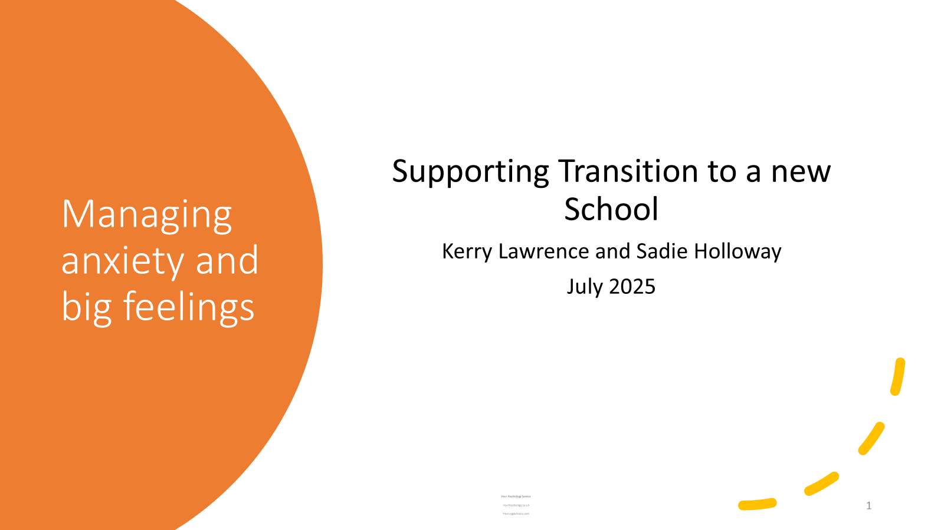
Slide 2

Slide 4
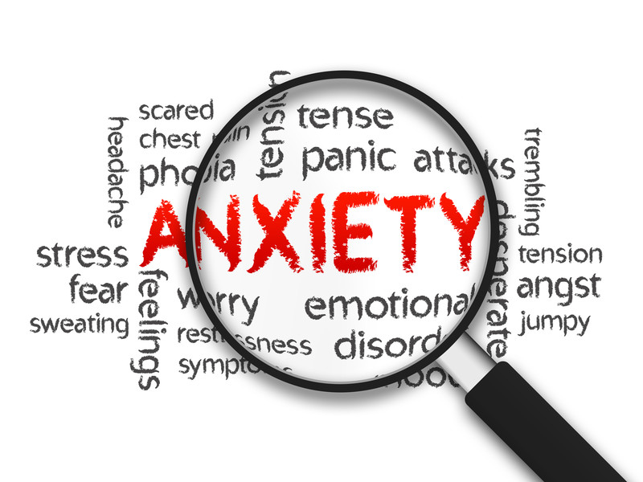
Session aims
Identifying the range of emotions children experience with transition.
To explore what anxiety is and how to spot it.
Practical tips to help children to manage anxiety about transition.
Notes:
Within the session today we are going to be looking at:
Identifying the range of emotions children are likely to experience with transition.
To explore what anxiety is and how to spot it, because it isn’t always easy to know when children are feeling anxious. Some children are able to recognise how they feel and tell us using words, for others this is so much harder and instead, they show us how they are feeling through their behaviour. So we are going to be looking at key behaviours from our children that might tell us that they are feeling anxious.
Practical tips to help children to manage anxiety about transition. Some of these may be familiar to you, and others will compliment what you are already doing to help your child.

Slide 5

Keeping us safe within the discussion
Confidentiality.
The right to pass.
A culture of respect.
Notes:
Talking about anxiety and our children’s experiences within a group can be hugely helpful and there are ways that we can approach this that are important to help us all to feel safe within the session today. Within this we need to agree to confidentiality, whereby if someone shares something about their child or family, it needs to stay within the room and not shared elsewhere. Is everyone happy to agree to this? The only exception is that if someone shares something that could indicate a safeguarding risk it will need to be shared with the school’s safeguarding team.
We have planned some discussions today to help us to think about our children, their experiences and how the techniques we’ll be looking at today can help them in their lives. In order to get the best from the session today, contributing to the discussions and joining in can be really beneficial. That being said, it’s not always easy to do so there is always a right to pass within discussions if that feels more comfortable to you. Please join in at any level that feels comfortable.
It’s important we uphold a culture of respect within the group, so within that we’re referring to everyone having a turn to talk (if they want to), listening to others and it’s also important to not share information about primary schools (if you have concerns you would like to discuss we can do so separately).

Slide 6

Moving on up
What are the positives about starting secondary school?
Notes:
Secondary transition comes with lots of opportunities for children as well as things that might cause anxiety. For many of us, change can be exciting but also unsettling, as humans we are usually creatures of habit, who feel safe in what is known and familiar.
When children feel anxious about something, their minds can become overly focused on the threats or the challenges they perceive about a situation. It can be really helpful to support a balanced view about secondary school and we wanted to start the session today with a discussion about what positives and opportunities your child may foresee for secondary school?
Ask parents to discuss this with people sitting around them. This should be a straightforward activity to ease them into the concept of group discussion.
After 5 minutes ask if anyone is happy to share the things they had identified with the group. You can add your own experience to this discussion and elaborate on points raised so it becomes chatty in nature.

Slide 7
Moving on up
What challenges do you / your child foresee?
What feelings do these challenges invoke? Anxiety? Sadness? Fear? Loss?
Homework
Reduced support
Feelings of sadness
Moving around the school
Getting lost
The size of the school
The work being too hard
New teachers
Toilets
New friends
Lunchtime
Bullying
Notes:
For many of us change can be unsettling and anxiety about something that is new and unfamiliar is probably something we can all relate to.
Moving from primary to secondary school brings apprehension for most children, but for some it can be more than this. Pupils have to adapt to a more challenging school setting where the nature of their learning changes. There are more teachers, more classrooms, increased homework, increased responsibility to content with. This can generate big feelings and responses within children.
Sometimes children know the specific things they are anxious about, sometimes they don’t and just have a general feeling of anxiety and unease.
Introduce a discussion now about what things they or their children are anxious about with regard to secondary transition. Do their children know how they feel / what they are anxious about or are parents having to infer this (normalise that this is okay).
After 5 minutes take some feedback from the group. It can be really helpful for parents to hear that others are in the same situation and that their child is not alone in this.
Recognising how our children are feeling and understanding some of the triggers can help us to discuss it with them and help them to be more aware of their emotions and ways to manage them. This brings us onto looking at what anxiety is.

Slide 8
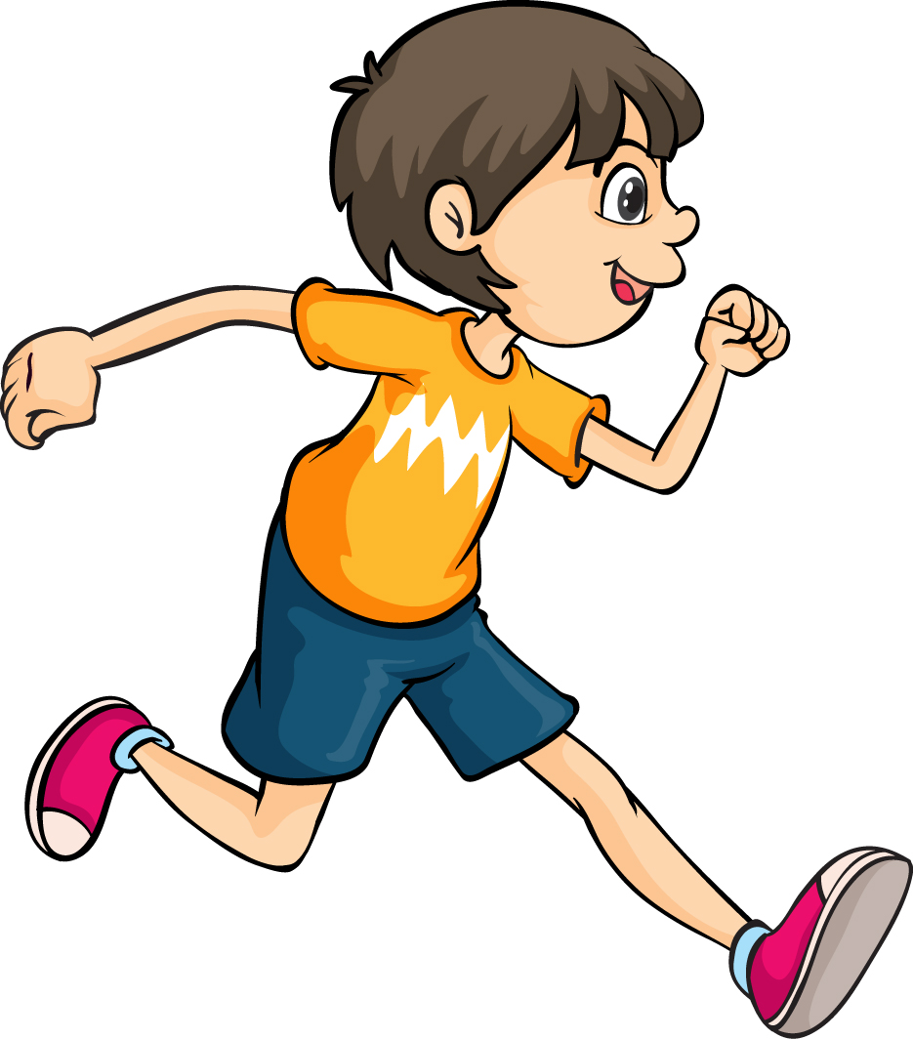
What is Anxiety?
It isn’t always easy to spot anxiety in children.
Anxiety is a normal emotion that although unpleasant, has an important job.
Small amounts of anxiety can be helpful when we need to perform.
Anxiety becomes a problem when it causes a high level of distress, lasts a long time and stops us from doing day-to-day things we enjoy.
Notes:
Recognising anxiety in our children isn’t always easy. Some children can recognise how they feel and tell us using words, others can give us pretty big behavioural signals that something is wrong, and for others we have to try to be detectives to figure out what is going on for them. To help us to do that, it’s valuable for us to have an understanding of what anxiety is and how it impacts the way our children might behave.
Anxiety is a normal emotion that we can all probably relate to. We have probably all felt the uncomfortable feeling of anxiety at some point in our lives, you might even have felt anxious about coming to the session today.
Although anxiety feels unpleasant, it serves as an important protective function because it warns us about danger. The feeling of anxiety keeps us safe. For example, if we didn’t feel anxious about getting hurt, we might not put our seatbelt on in a car. If we didn’t feel anxious about our personal safety, we might not lock our front door at night.
In addition to holding a protective function, we also know that small amounts of well-managed anxiety can even be helpful in certain areas. For example, the adrenaline release we experience when we feel anxious can improve performance in sporting events (likes races) or tests we have to take.
Anxiety however becomes a problem when it causes a high level of distress that seems disproportionate to the trigger, lasts a long time (more than 2 weeks) and stops us from doing day-to-day things we enjoy. These things tell us that a child might need some extra help.

Slide 9
Anxiety has 4 parts
Thinking part: The anxious, negative thoughts.
Feelings part: The feeling of anxiety, fear and nervousness in your body.
Physical part. This includes the physical sensations of anxiety, such as nausea, sweating, shaking, dry mouth and increased heart rate and breathing.
When children experience anxious thoughts, feelings and physical symptoms it can lead to distress (challenging) behaviours:
Behavioural part. Running away, hiding / avoiding, ‘shutting down’, lashing out, shouting, confrontation, throwing things.
Notes:
Anxiety has 4 main parts and knowing this helps us to spot it in our children.
Thinking part: Anxious negative thoughts. This is a bit like a negative voice in your head that tells you unkind things about yourself like:
I can’t do it.
I’m no good.
Everyone will laugh at me.
No one likes me.
Feelings part: The feeling of anxiety, fear and nervousness in your body.
Physical part: This includes the physical sensations of anxiety, such as nausea, sweating, shaking and increased heart rate and breathing. Children will often mistake anxiety for being poorly because of the huge impact it can have on their bodies.
When children experience anxious thoughts, feelings and physical symptoms it can lead to distress (challenging) behaviours:
Behavioural part. Running away, hiding / avoiding, ‘shutting down’, lashing out, shouting, confrontation, throwing things.

Slide 10
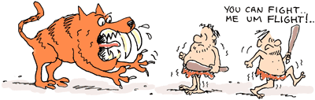
The Fight/Flight/Freeze System
Why does anxiety trigger challenging behaviour?
There is a clear link between our feelings and behaviours when we feel anxious and this is mediated through the fight / flight / freeze system.
Our fight / flight / freeze system is responsible for keeping us safe. It hasn’t really changed much since we were cave men.
As a cave man, feeling anxious was usually triggered by a life-or-death situation (like facing a saber tooth tiger)! In a life-or-death situation our fight / flight / freeze system kicks in and takes over our brain.
‘Survival mode’ is triggered and our brain prepares our body to be able to fight the threat, run away from it (flight) or freeze and hide.
Notes:
Why does anxiety trigger challenging behaviour?
There is a clear link between our feelings and our behaviours when we feel anxious and this is mediated through the fight / flight / freeze system, which is a term you may already be familiar with?
Our fight / flight system is responsible for keeping us safe. It’s one of the oldest parts of the brain and it hasn’t really changed much from when we were cave men.
As a cave man, feeling anxious was usually triggered by a life or death situation, like facing a sabre tooth tiger! When we’re in a life or death situation our fight / flight / freeze system kicks in and takes over our brain.
It triggers ‘survival mode’, where our brain prepares our body to be able to fight whatever is causing the threat, run away from it (flight) or freeze and hide.

Slide 11
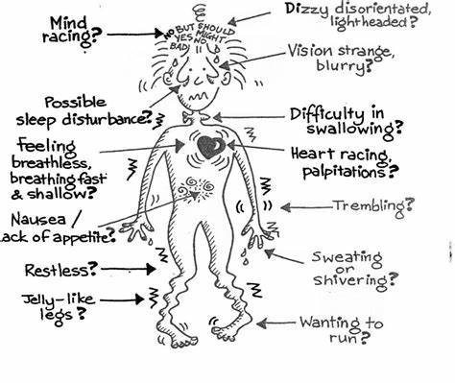
The fight / flight / freeze system
Our fight / flight system is important in keeping us safe in life and death situations. It allows us to act quickly, without thinking to fight the threat, avoid it or hide and freeze.
The problem is that it is often triggered in non-threatening situations such as tests, social events or starting secondary school.
It is the fight / flight / freeze system that causes many of the unpleasant feelings in our body as our brain prepares to fight / flight / freeze:
  Increased heart rate and breathing.
  Tense muscles.
  Increase in body temperature.
  Tummy ache (the digestive system slows down because it is not needed).
  Headache.
  Shakey hands and voice.
Notes:
The fight / flight system is important in keeping us safe in life and death situations. It allows us to act quickly, without thinking to fight the threat, avoid it or hide and freeze.
The problem is that it is often triggered in non-threatening anxious situations, such as tests, social events, public speaking……or perhaps starting secondary school.
It is the fight / flight / freeze system that causes many of the unpleasant feelings in our body as our brain prepares to fight / flight / freeze (see list on slide).
Ask parents if they can relate to any of these physiological changes? Anxiety has a very real impact on the body.
****Parents might ask about panic attacks here. For some children the anxiety response can develop into a panic attack where the breathing and heart rate increase substantially. A panic attack is an extreme fight / flight / freeze response and it can feel as though it is difficult to get enough air. Actually, the opposite is happening and the survival part of the brain has gone into overdrive and is telling the body to over breathe. One of the best ways to manage panic is to slow the breathing down, even though it is the opposite to what the brain is trying to do.

Slide 12
Survival responses
So what does ‘survival mode’ look like through our behaviour?
These behaviours are not choice behaviours (although children can learn to overcome them) and signal to us that children are feeling anxious and that a state of fight / flight / freeze has been triggered.
Fight | Shouting Swearing Aggression (physically lashing out at themselves or others)
Flight / freeze | Avoidance Running away Non-communicative
Freeze | Shutting down Non-communicative Avoidance
Notes:
Read as on slide.
Ask the group whether they recognise any of these behaviours / responses in their own children? Is anyone happy to share (boundary this to 3-5 minutes).
Emphasise that these behaviours are often associated with anxiety and are not choice behaviours, although children can learn to overcome them.

Slide 13

Signs of anxiety
Difficult behaviour is therefore usually a signal of anxiety or other difficult feelings (like frustration, embarrassment or shame).
A really helpful way to imagine this is through the concept of an iceberg. The behaviour is what we see on the surface (the ‘tip of the iceberg’), and hidden underneath this is often anxiety.
Children aren’t always aware of the feelings behind their behaviour so as parents we can act as detectives, is to help them to identify what is going on emotionally.
What is the behaviour?
Underlying anxiety about….?
Notes:
Difficult behaviour is therefore usually a signal of anxiety or other difficult feelings (like frustration, embarrassment or shame).
A really helpful way to imagine this is through the concept of an iceberg. The behaviour is what we see on the surface (the ‘tip of the iceberg’), and hidden underneath this is often anxiety.
Children aren’t always aware of the emotions underneath their behaviour so as parents we can act as detectives, is to help them to figure out what is going on.
Handout – ask the parents / carers to have a go at completing an iceberg for their child. Ask them to think of a time their child was feeling anxious. What behaviour was apparent on the surface? What was the underlying anxiety about (it is okay to infer this, we don’t always know and this is okay!).

Slide 14
Signs of anxiety
Feeling sick, shallow or quick breathing, headache, tense muscles, wobbly legs, IBS, diarrhoea.
Confrontational behaviour.
‘Meltdowns’.
Preoccupied by negative thoughts and self doubt.
Difficulties concentrating.
Withdrawing / isolating.
Sleep difficulties
Repeating certain behaviours / actions.
Eating more or less than usual.
Skin picking or hair pulling.
Notes:
Many of these are likely to have been covered in the discussions already, however this is a list of behaviours that can indicate that a child is feeling anxious. Many of these are associated with the fight / flight response.
Sleep difficulties – these are often associated with a fight / flight response because when the brain is in survival mode it perceives a threat. If the brain perceives a threat, it considers it unwise to put us in the vulnerable position of going to sleep where we cannot defend ourselves (even though most things that cause us anxiety do not need us to do this).
Repeating certain behaviours / actions – this can be a way children try to gain a sense of control or autonomy when the world feels out of their control. You may find that they try to control things at home or with you as a coping mechanism.

Slide 15
What can parents/carers do to help?
Tip 1: Support the feeling through the ‘naming and taming’ approach.
Tip 2: Help them to manage their fight / flight system.
Tip 3: Help them to think about times when they’ve managed change before.
Tip 4: Break big things down into small steps.
Notes:
In the first part of the session we’ve spent time exploring what anxiety is, understanding what happens in the brain when children are anxious (the fight / flight / freeze system) and how we can recognise behaviours in our children that may indicate anxiety.
In the second part of the session, we are going to go through some ‘top tips’ that can help children to manage anxious feelings, specifically about transition to secondary school. You will already be doing lots to help your children and these approaches will compliment the strategies you already have in place.
The tips we are going to be exploring are (read from slide…..)
It’s not possible to put all the strategies will discuss into place, please treat this section as being like a menu and choose one or two things that you think could be helpful for your child at home.
Give out handout 2 – ‘Things I am going to try’.

Slide 16
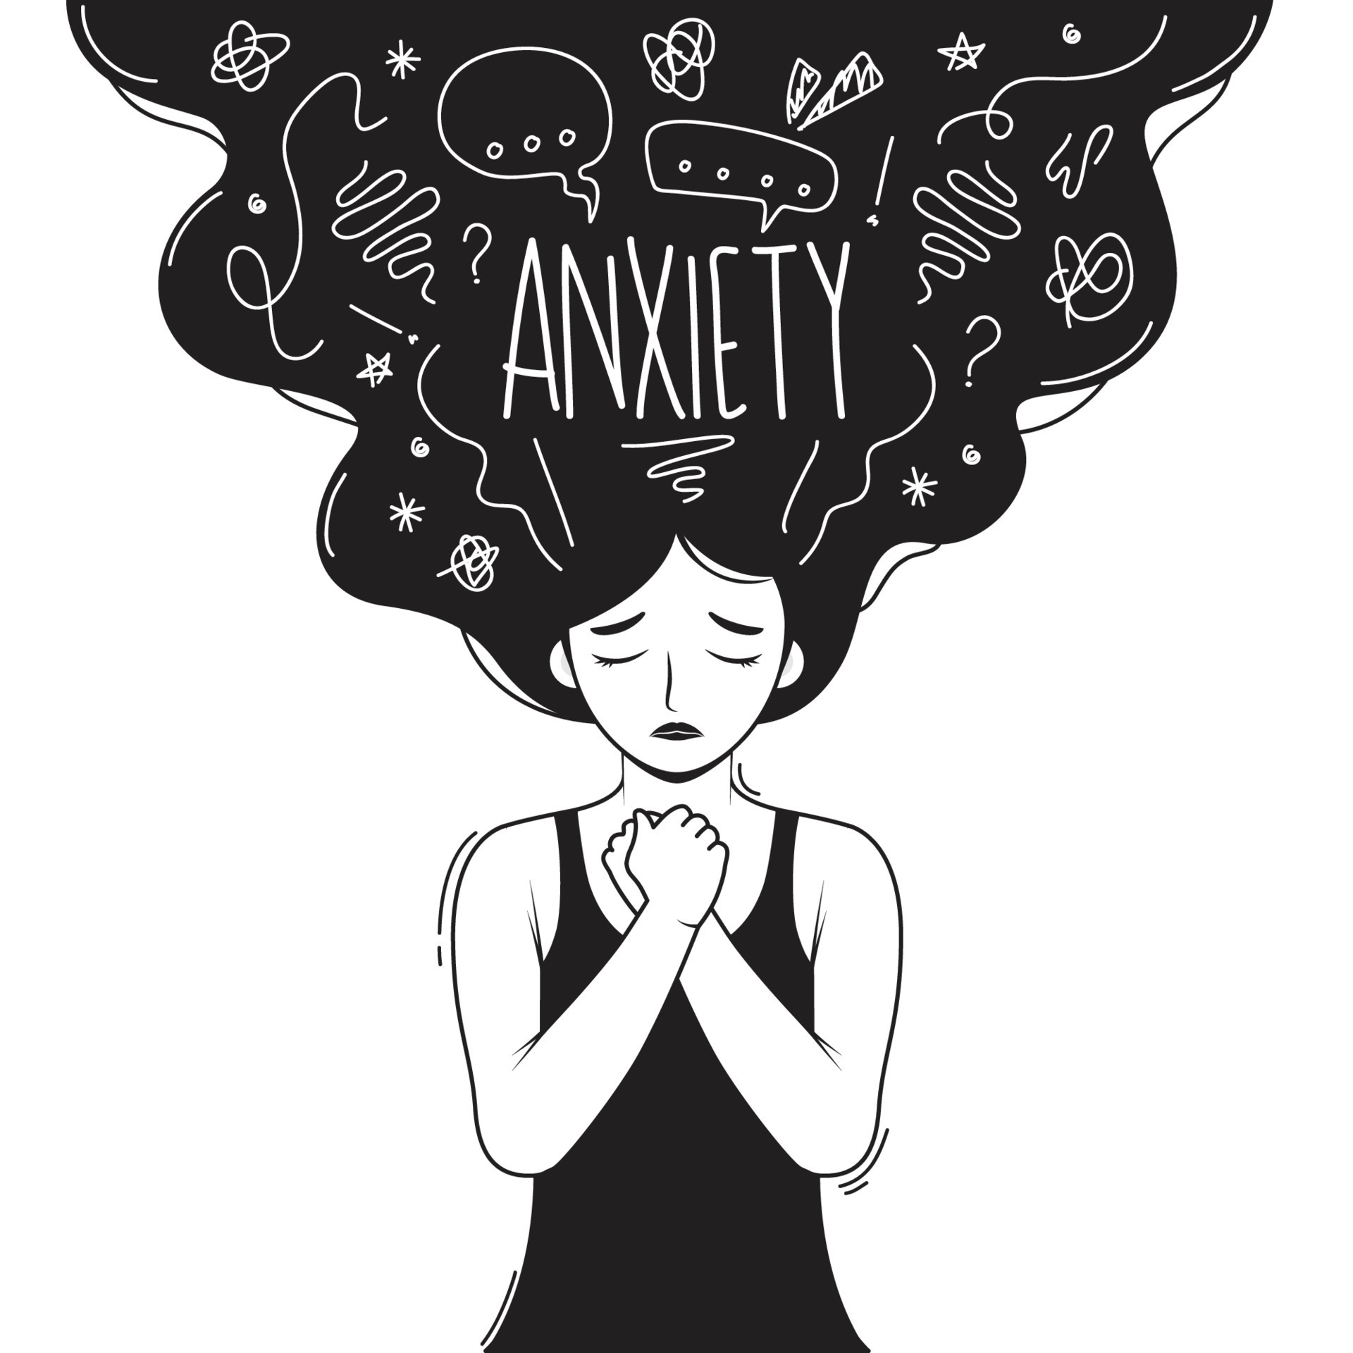
How parents/carers can support feelings -
‘naming and taming’
The experience of being listened to and validated is what we want to replicate for our children when they are anxious.
Often as adults, we jump to providing reassurance for children when they are anxious, telling them that they have ‘nothing to worry about’, or that they are ‘fine’. Whilst this is well intentioned (and there is certainly a place for reassurance), it can leave children feeling misunderstood, misheard and the emotion remains strong.
Instead, we want to name how we think children are feeling (put this into words for them) and really validate how difficult it must be to feel that way.
We want to show to our child that we understand how they feel and that we can connect with the difficult emotion they are having.
Notes:
It is important to explain on this slide that as parents and carers, we absolutely want the best for our children and that when they experience distress, it triggers something really uncomfortable within ourselves. When we see our children in pain, we are predisposed to want to fix it (to take the feeling away), to want to make things right and that often leads to us jumping in and telling them everything is going to be fine, because it is a natural response (it is important to really emphasise this to normalise and prevent any guilt about responding in this way – we all do it! And we do it because we care.).
It isn’t intuitive to name and sit with uncomfortable feelings for our children and it takes time and practice. But where we can see that our children are anxious, if we can talk to them about how we think they are feeling and validate how difficult that must be for them…before we go on to reassure them, it can be a really powerful approach.

Slide 17

How parents can support – Naming and Taming Feelings
The approach is called naming and taming, because we know that if we can name difficult feelings for children (verbalising how we think they are feeling), it can literally tame them. Naming feelings can reduce the intensity of the feeling being experienced, which is pretty powerful stuff.
There are 3 steps involved
  1 – Be the detective – how do you think your child feeling?
  2 – Name and validate the feeling for them (put it into words).
  3 – Provide reassurance or identify ways to manage the problem.
We call this ‘connection before correction’. We connect with the feeling, before we give guidance or reassurance.
Notes:
The approach is called naming and taming, because we know that if we can name difficult feelings for children (telling them how we think they are feeling), it can literally tame them. Naming feelings, reduces the intensity of the feeling being experienced which is pretty powerful stuff.
There are 3 steps involved:
You are going to be a detective and observe your child to figure out how you think they are feeling (just like we did in the ice berg activity)
You are going to put into words what you think is going on for them emotionally (I wonder if you are feeling really worried about school today?).
You are going to provide reassurance or identify ways to manage the problem.
We call this ‘connection before correction’. We connect with the feeling, before we give guidance or reassurance to correct.
We need to be aware that not all children are ready to hear about or talk about their emotions in the moment and that’s okay. Sometimes it is better to do this when children have calmed and they will still benefit from this approach.

Slide 18
How parents/carers can support – Naming and Taming Feelings
For example, your child is crying and refusing to get ready for school because they think they are going to be told off for not understanding their homework.
Be the detective. What emotion do you think the child is feeling?
Name and validate the feeling: I see that you are upset and I wonder if you are feeling really anxious about your homework? I can see how distressing this is for you and I know how tough it is to feel anxious. This must feel really uncomfortable.
Provide reassurance / problem solve: What can we do to help you to feel less worried about this? Would it help for us to talk to your tutor?
When we ‘name and tame’ in this way, we are not agreeing with the emotion or that they have reason to feel worried, rather we are simply recognising and validating the way they feel.
Notes:
Connect and talk about the feeling before problem solving and reassuring.
It is important to emphasise that validating does not mean agreement. We are not agreeing with the child that they have reason to feel anxious, or that they will get told off within school. Rather, we are simply recognising and validating the way that they feel.

Slide 19
Naming and Taming Feelings
Example:
Andrew is about going to his transition day tomorrow and he doesn’t know anyone, he’s been shouting at his parents all evening and has just thrown his bag across the room.
What is the feeling? Anxiety
How can we name this to tame it? I wonder if you are feeling really anxious about your transition day tomorrow and that’s why you’ve been shouting at us. I guess you’re worried about not knowing anyone and whether you’ll have kids to talk to? I understand that, I know I feel worried to when I have to go to new places, it can be really tough. Does that feel right to you?
Provide reassurance / problem solve? I wonder what we can do to help with this? I remember when you started football you didn’t know anyone but made friends quickly, do you think it could be the same at school?
Notes:
Share this example with the group. There’s no single right way to respond, it’s just about trying to name and validate what you think is going on for your child before looking at reassurance.

Slide 20
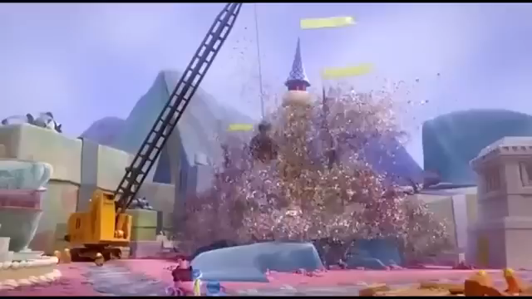
Video
Notes:
We’re going to have a look at a really lovely example of how the ‘naming and taming’ approach works in practice using a clip from the film ‘Inside Out’.
In this clip you will see two different approaches to responding to a character’s (Bing Bong’s) distress. One character goes straight into fixing and problem solving (what we are often tempted to do as adults when our children have a problem or worry). The other sits and names how they think the character is feeling and validates this.
Notice the differences between the approach and we will share thoughts after the clip.
Allow 5 minutes for discussion about the two different approaches within the clip. Notice that ‘Bing Bong’ does not need ‘Sadness’ to give advice or solve the problem, he just needs to feel validated.
It is important to emphasise with this clip that it’s a cartoon and that in real life, it won’t always be as straightforward at this (although it would be nice if it was).
Hyperlink for the clip:
Bing Videos

Slide 21
Naming and taming feelings
Why does it work?
There are so many wonderful benefits to using this approach:
Naming feelings for children helps them to recognise their own emotions and words to express these (a key skill for good mental health).
Naming feelings for children stimulates calming hormones in the brain that inhibits (deactivates) the fight / flight system. We can calm the brain and reduce the intensity of how children feel by naming how we think they feel and connecting with their emotions. Naming feelings can literally tame them.
Naming feelings for children triggers bonding hormones in the brain (oxytocin) that helps children to feel more connected to us, which helps to reduce their anxiety.
Notes:
Some children find it really hard to recognise or understand how their emotions. When we put this into words for them, it helps them (over time) to understand that there is a word for this particular feeling. With lots of practice, this should help them to communicate how they are feeling through words, rather than behaviours.
2) We have some really cool neuropsychology studies that show physical changes in brain occur when name and validate feelings for children. Naming feelings literally tames them and we can see that the fight / flight system starts to calm through this approach.
3) It also helps children to feel connected to us through a sense of feeling understood.

Slide 22
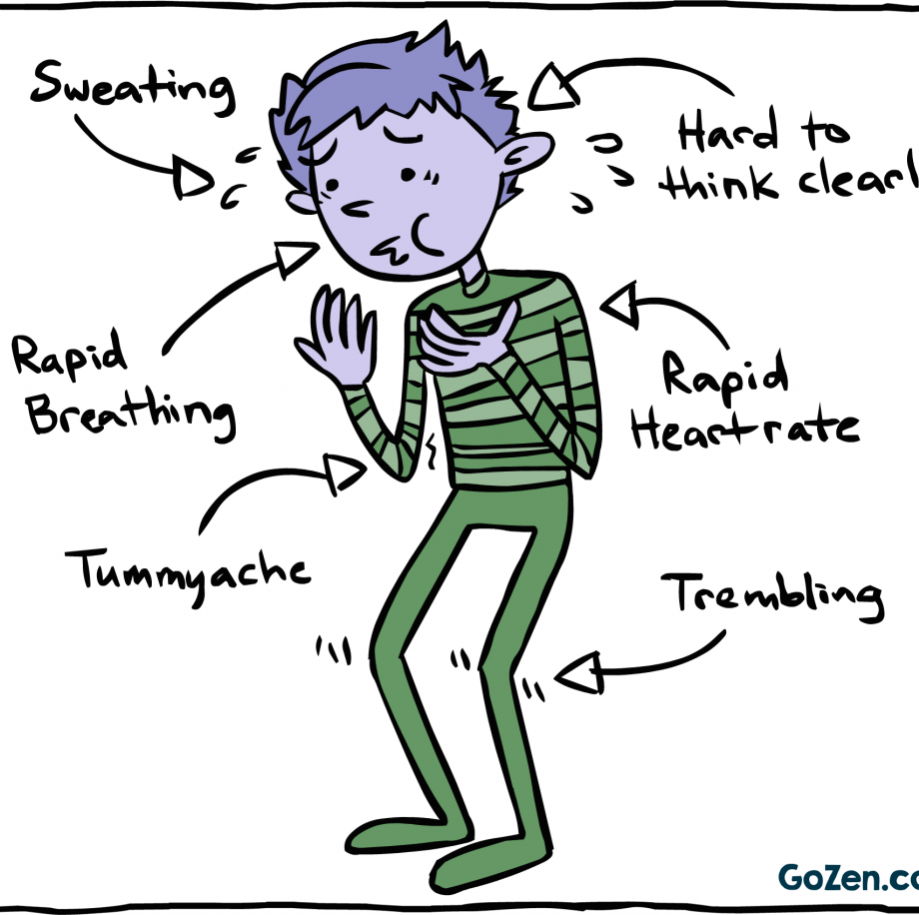
Top tip number 2
Teach them how to manage their fight / flight response.
Notes:
The second top tip that we are going to look at today involves teaching children strategies they can use to manage feelings of anxiety.
This gives them some control over their emotions and activities that they can use to calm their fight / flight system down.
When the fight / flight system is triggered they might experience:
Increased heart rate.
Increased breathing.
Shakey hands.
Tummyache.
Sickness.
Headache.
One of the best ways to calm the body and manage these symptoms is by slowing the breathing down. This tells the fight / flight system that the body is safe and that it can go back to a rested state.

Slide 23
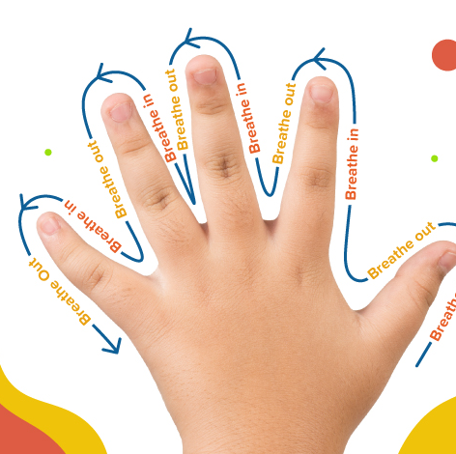
Breathing strategies
Hand breathing
Square breathing
Breathe in and sniff.
Top Tips:
Practice breathing exercises with children when they are calm so it becomes a well practiced strategy that they can use when feeling anxious.
If children are reluctant to do breathing exercises with you, model this to them (show them that you practice regulated breathing exercises when you are feeling anxious or stressed). Children won’t always do what they are asked, but they will often copy.
Notes:
There are lots of different breathing activities you can try with your child, and you and your child may well already be familiar with some of these approaches.
Regulated breathing is a great strategy to teach children because they can do it any time, any place and without anyone knowing. And it really does help to calm the fight / flight response.
Share handouts detailing the breathing techniques
Activity: Allow 5 minutes to practice these breathing exercises with the parents. What do they notice? Does it have a calming impact on the body? Do they have a favourite?
It can be helpful to practice breathing exercises with children when they are feeling calm, so that they are familiar with the approaches and find it easier to implement when anxious.
If children are reluctant to do breathing exercises with you, model this to them (show them that you practice regulated breathing exercises when you are feeling anxious or stressed). Children won’t always do what they are asked, but they will often copy.
Sometimes children can be reluctant to engage with parents in breathing exercises. If they will do it with you great, if not, you can leave the resources for them to look at themselves, or share an online resource (there are lots of guided breathing videos on YouTube kids).

Slide 24
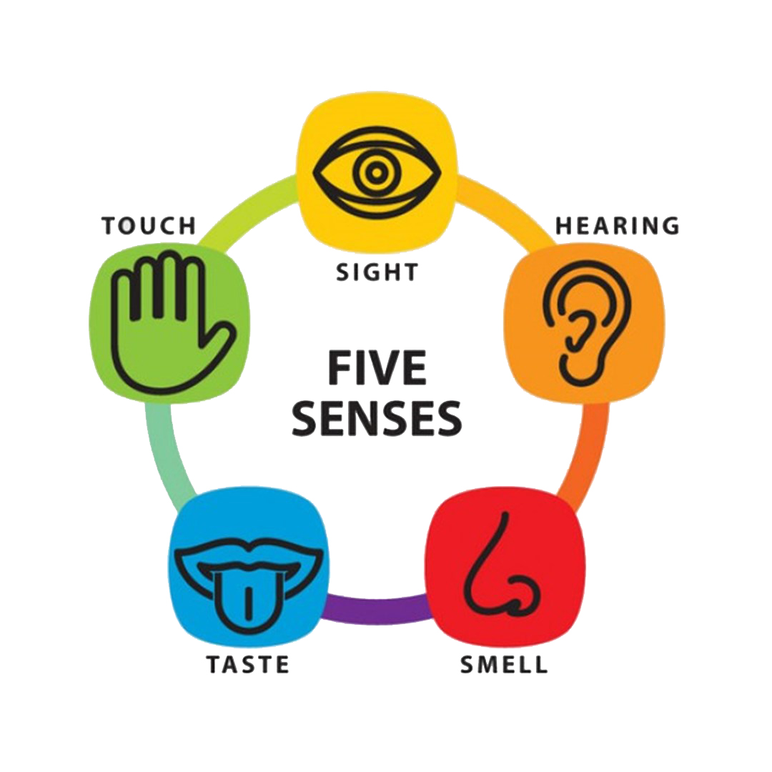
Grounding approaches
Find 5 things you can see
Find 4 things that you can hear
Find 3 things that you can touch
Find 2 things you can smell
Find 1 thing you would like to taste.
Notes:
Share grounding handout
Grounding approaches can help to reduce anxiety and bring children out of anxious and worrying thoughts, and back to the present moment. Focusing on the senses and the present moment can help reduce anxiety. Grounding is a simple approach that can be used to calm the fight / flight system by focusing on what is going on is around you……..
Find 5 things you can see
Find 4 things that you can hear
Find 3 things that you can touch
Find 2 things you can smell
Find 1 thing you can taste.
It can be difficult to remember this sequence and so writing it out for children on a post-it or piece of paper to keen in their pocket or bag can be helpful.
Again it is a really nice strategy that children can use in any time, any place and without anyone knowing. They can use it in the exam hall before they start their paper for example to help to focus their attention and help to settle their nerves, or on the way to school on a transition day.

Slide 25
Top Tip number 3
Change is something that we have to manage throughout our lives. Sometimes changes are small and occur throughout the day, sometimes they are big and infrequent.
Starting secondary school is a significant change / new experience for children, but many of them will have managed significant changes / new experiences before and it can be helpful to encourage children to think about these times to demonstrate to themselves that change is not new to them and most importantly that they can cope.
Teach them to think about a time when they have felt nervous about a change:
  Was the reality as bad as they thought (thoughts are not facts )?
  Do they still feel nervous?
  What skills did they utilise to get through it?
  What strengths and skills do they have to manage this change?
Notes:
Info on the slide…..
Starting secondary school might be a new experience for children, but managing change is not.
Thoughts are not facts. We all have negative and intrusive thoughts about things that worry us. The problem isn’t that we have them….it’s that we believe them. Yet thoughts are just thoughts, they are self created, mental events that often get distorted by our emotions. We accept them as true when often they are not (they usually at least lack validity). By noticing our thoughts and having the mantra ‘just because I think it, doesn’t make it true’ it can help the thoughts to have less control.
Activity: share the ‘managing change worksheet’ and ask parents to complete this on behalf of their child. Allow 5 minutes for this activity.

Slide 26
Top tip number 4 Break things down into small steps
Starting secondary school leads to lots of new changes that can feel overwhelming when thought about as part of a ‘bigger picture’. This can include:
  New teachers.
  New building.
  New journey to school.
  New uniform.
  New equipment.
  New timetable
It can be helpful to brainstorm with your child the new things they are worried about, and focus on preparing them for these (where you can), one at a time, in small steps.
It can also be helpful to draw their attention to the fact that things don’t stay ‘new’ for long and that often the anxiety is not as bad as we anticipate.
Notes:
Children have to think about new teachers, new building, a new journey to school, new uniform, new equipment, new timetable.

Slide 27
Parent/carer experiences of transition
Transition is a huge milestone for parents as well as and often triggers big feelings within ourselves as adults.
It’s a big step, represents an increase in independence, another step towards adolescence.
It is important not to hide our emotions from our children but we need to be aware that children take their cues about a situation from the way we respond as adults.
Adults set the emotional climate and so we need to be aware of how and what we are communicating about school in the way we talk to children about school and the way we speak to others about school in their presence. What do we want to model to them?
Notes:
Transition is a huge milestone for parents and often triggers big feelings within ourselves as adults. It’s a big step, represents an increase in independence and another step towards adolescence.
For parents there is often safety at primary school with one key person to deal with, one point of contact. Secondary environments are bigger and can feel more difficult to negotiate. Particularly if your child has an SEN or is anxious within school.
You might also have had your own difficult experiences at secondary school and this may be particularly triggering as your child starts secondary school.
Parents need to be aware of their own emotions because children are like sponges. They soak up how we feel.
It is important not to hide our emotions from our children but we need to be aware that children take their cues about a situation from the way we as adults respond. Adults set the emotional climate so we need to be aware of how and what we are communicating about school in the way we talk to children and the way we speak to others about school in their presence (children are often listening!). What do we want to model to them?

Slide 28
Parent/carer experiences of transition
The importance of being kind to yourself during this stage of life.
How are you doing?
What does this change mean for you?
Where can you access support to talk about your feelings / what can you do to be kind to yourself?
Notes:
In the same way that it is important for us to listen to and validate how our children feel about transition, having support for our own emotional responses is important too and we need to be kind to ourselves. Being a parent is tough. Parenting children who feel anxious is even tougher and it can raise a lot of difficult feelings for parents.
It is important to think about how you are doing?
What does this change mean for you?
Where can you access support to talk about your feelings? This may be family, friends or key adults in school.
Open this out to the group to consider independently or as a group. How are you feeling about transition? What does this change mean for you? What can you do to help you to manage your own feelings about this?

Slide 29
Summary
Transitioning to secondary school can generate a range of emotions for children.
All emotions are okay to have and it’s normal for children to have big feelings.
Big feelings like anxiety can trigger the fight / flight system and impact behaviour.
There are lots of things that you as parents are already doing to support your child, alongside things that can compliment this.
Take care of yourselves as parents, this is a big change for you too.

Slide 30
If you are still concerned
There are people who can help! Ask for help if:
  The anxiety is high.
  It is having an impact on daily functioning.
  It does not improve.
  It is leading to concerning or risky behaviour such as self-harm.
Talk to school.
Seek professional help if you are worried about your child’s mental health and things aren’t getting better.
Talk to your GP.
Notes:
Of course all of the strategies we have talked about today can be really helpful, however there are people who can help outside the family home when you are concerned about anxiety.
Ask for help if:
The anxiety is high.
It is having an impact on daily functioning.
It does not improve.
It is leading to concerning or risky behaviour such as self-harm.
Talk to school.
Seek professional help if you are worried about your child’s mental health and things aren’t getting better through your GP.

Slide 31

Slide 6
Any Questions?
Any questions?

Slide 32

xxxx
Transition Resources from Lumi Nova
Lumi Nova is offering transition resources. The summer holidays are a great opportunity for parents/carers to use Lumi Nova to support their children with common worries during this time.
Whether it's the start of a new school year, transitioning to a new school / class or making new friends, Lumi Nova offers a wide range of goals to support children build confidence.
Download the Transition / Summer Resources from Google Drive
To request a physical pack of free resources to hand out at the end of term, please contact the team at luminova@bfb-labs.com.

Slide 33
xxxx
SEND Updates – What’s New?
The Worcestershire SEND service is restructuring to support improvements in the service.
These are the current key changes you need to be aware of:
• Following Parent Carer and staff feedback, Casework Officers are now going to be called ‘EHCP Co-ordinators’
• More staff: 4 EHCP Co-ordinators, 1 Team Manager, 1 Senior EHCP Co-ordinator, 2 Initial Screening and Contact Officers and a second Complaints Officer

Slide 34
xxxx
• New Pre-14 and Post-14 teams split by area – so children are supported by a team that understands their educational phase best
• A new Postcode Finder tool so families can easily see which team supports their child
• Each team will have their own phone number and email address so it’s easier to get in touch, even when individual EHCP Co-ordinators are unavailable.

Slide 35
xxxx
The children and young people will be moving to their new teams during June and July, and the new structure will be fully in place from 1st September 2025.
Families can continue to contact their current EHCP Co-ordinator and the SEND Services Team via the usual channels and will be updated as and when things change.

Slide 36
xxxx
Please note, the EHCP process remains the same – there is no change to the Code of Practice.
You can find out more about the EHCP process, including the restructure, on the SEND Local Offer website:
https://www.worcestershire.gov.uk/council-services/schools-education-and-learning/send-local-offer/ehcp-education-health-and-care-plans
SEND Services | Worcestershire County Council

Slide 37

xxxx
Any questions?
Any suggestions for specific issues you’d like to cover in future sessions?

Slide 38
Learning Advocates
Wychavon & North Bromsgrove - Sam Purser spurser@worcestershire.gov.uk
Wyre Forest - Paula Hemming phemming@worcestershire.gov.uk
Worcester City - Sadie Hollow SHolloway2@worcestershire.gov.uk
Redditch & South Bromsgrove - Mary Williams mwilliams2@worcestershire.gov.uk
Roman Catholic Pyramid - Anne Griffin AGriffin@worcestershire.gov.uk
Out of County - Fiona Eades FEades@worcestershire.gov.uk
Out of County - Steve Judd sjudd@worcestershire.gov.uk
Post 16 - Jill Peplow JPeplow@worcestershire.gov.uk
Post 16 - Jess Reece JReece@worcestershire.gov.uk
Early Years (2, 3 & 4 year olds) – Sara Haigh SHaigh@worcestershire.gov.uk
Early Years (Reception age) - Becky James BJames@worcestershire.gov.uk

