Slide 1

Designated Teacher
Updates and Guidance Session
Spring 2025

Slide 2
Agenda Tuesday, 8th April 2025
WAGOLL – Paula Hemming & Sam Purser, VS Learning Advocates
SEND update- Mary Williams, VS SEND Lead & Learning Advocate
PEP Updates and questions – Paula Hemming, VS Learning Advocate.

Slide 3

WAGOLL
What a Good One Looks Like
April 2025
Each section has been completed for that particular section, it may not relate to other sections of the form.
The WAGOLL is an amalgamation of several CYP, of different ages, and is an example of the detail required.
There can never be too much information on the PEP!

Slide 4
The importance of completing the forms in advance of the meeting:
Allows Learning Advocate to review and come to the meeting prepared with support and guidance.
Generally shorter meetings, as all detail required is already recorded.
Alerts Learning Advocate to potential areas of concern or celebration.
The importance of submitting the forms within agreed timeframes:
Swift approval of funding.
Timely distribution of Quality Assured PEP document to all involved professionals.
Actions for the CYP can be implemented without drift and delay.

Slide 5
Post 16 Planning – SEND/EHCP
Specific Post 16 planning for ALL young people (including CLA) needs to begin in Y9.
Specific careers programmes should begin in Y7

Slide 6
Post 16 Planning
As a designated teacher you will often play a similar role to that of a parent / guardian and ensure that children in your care are as prepared as they can be to enter the world of work. Making sure that young people fully understand the wide range of career pathways and opportunities which are available to them is key to their preparation.
The DFE adopted the set of careers related standards known as the “Gatsby Benchmarks”. The Gatsby benchmarks formed a framework of standards that schools, and colleges can use to ensure they deliver a high-quality careers programme to students during their journey through education.
This includes SEN Schools.
OFSTED - All secondary schools are expected to provide effective careers information, education, advice and guidance (CIEAG), in line with the statutory ‘Careers guidance and access for education and training providers’
Careers guidance and access for education and training providers - GOV.UK
- Worcestershire Careers Explainer for DTs (produced Dec 2021)

Slide 7
CLA with SEND and /or an EHCP
Need Preparation for Adulthood (PfA) outcomes in their EHCP from Y9 forward –pathway planning.
Need revision of the EHCP, including provision, at end of Y9/early in Y10 so that it is suitable for post 16 consultations. Be aware that any specific requirements need to be supported by external professional advice. Get the Social Worker involved.
Need the young person’s aspirations. Listen to their voice. I was…, I am…, I will be…
Consider – does the young person still need the support of an EHCP post 16? Does the young person still want it? Can be a hinderance as well as a help. Needs may have changed.
A young person only needs 4 ‘meaningful encounters’ to reduce the risk of becoming NEET
SEN schools – what does this look like? Its not just about employment.

Slide 8

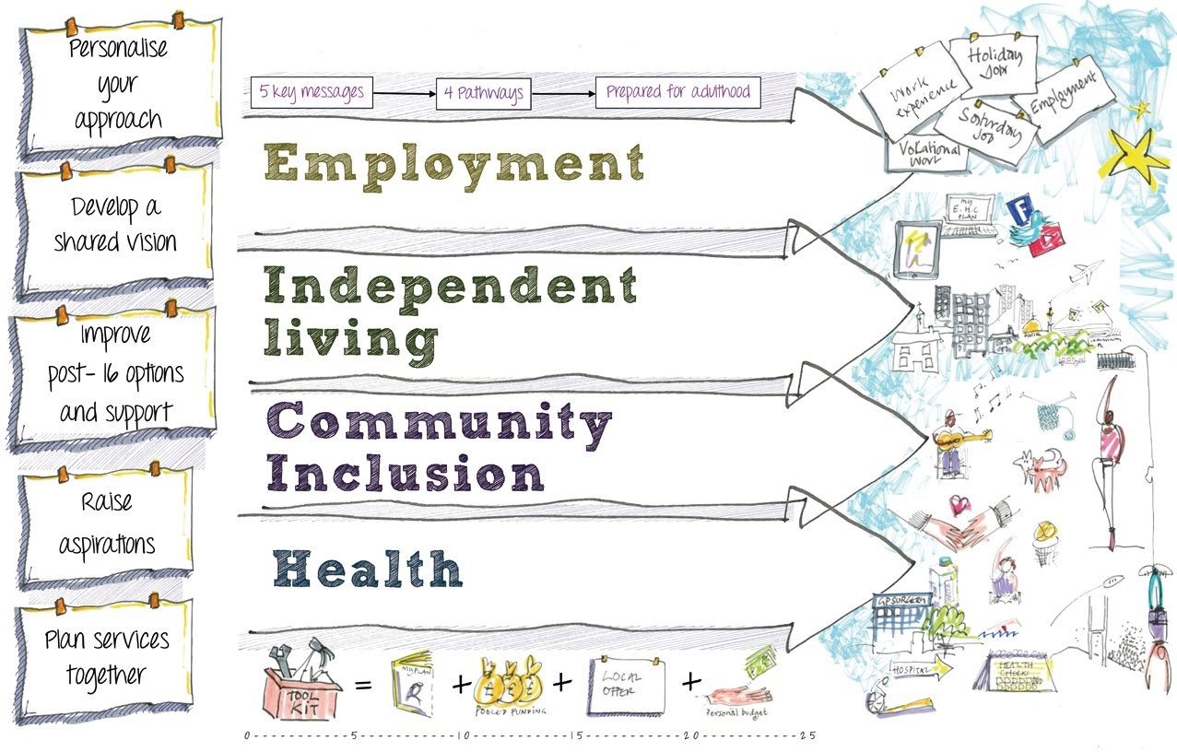
PfA Outcomes across the age ranges for children and young people with SEND
Revised Edition © 2017 Preparing for Adulthood | www.preparingfor

Slide 9
Contents
Employment Independent Living Community Inclusion Health
This supportive tool has been designed by the Department for Education (DfE) to promote consideration of the four PfA outcomes as part of EHC planning across the age range.
This includes consideration of aspirations, activity and provision that can support progress towards the PfA outcomes and what this might mean at different ages and stages of development. It is not intended to be a definitive list but is a starting point and we encourage feedback from colleagues testing out the tool in practice so that DfE can continue to develop it in the future.
Please get in touch at: info@preparingforadulthood.org.uk.
3
5
7
9

Slide 10
Things to remember when using the tool:
The outcomes will need to be personalised and focused on the young person’s aspirations, supporting as independent a life as possible
Children develop at different rates. For some young people indicators included in early childhood may continue to be outcomes they are progressing toward as they get older. Therefore it is important that each new age/stage continues to develop and build on the previous ones
At review meetings the tool can be used to support development of imaginative yet achievable ways to support progress under each outcome
This tool should be used as part of a personalised approach and can therefore be used as a starting point to develop EHC plans across a wide range of need. If you are supporting a young person with a life-limiting condition this tool can be used to focus on progress in a sensitive and personalised way
Use creative approaches to embed activities in the curriculum and in everyday activities outside of the classroom
Raise aspirations and expectations and encourage thinking about what the future might look like for children from an early age
Promote a focus on outcomes that are transferable to the real world
Local authorities should make sure they focus on the PfA outcomes in EHC plan reviews and make sure related information is covered in the local offer
The indicators included in this grid, although specified against a certain age, are applicable across the age ranges depending on cognitive ability i.e. a young person aged 17 may still be learning to feed themselves. Some indicators translate across outcomes
- ‘making choices’ and ‘managing change all applicable to all four PfA outcomes.

Slide 11



employment
Primary Reception Y2
Key Stage 1
5-7 year olds
Primary Y3-Y6
Key Stage 2
8-11 year olds
Age
Following instructions - consider any specifics around sensory impairment
Adapting to new environments
Playing with other children
Real world play (builder / nurse / doctor)
Numeracy
Real world visits (fire stations, farms etc.)
‘What do you want to be when you grow up?’
Meeting role models
Talk about different careers and education options
Access to career related role models
Start to build a personal profile of interests and ambitions
School sessions from visitors on their
careers
Steps Towards Outcomes
Achievement for all – Whole School Approach
Whole School SEND
Communication Trust
Children’s Sleep Charity
Aspirations for Life employment posters
Employment Video Case Studies
Aspirations for Life employment posters
Employment Video Case Studies
Resources

Slide 12


Secondary Y7-Y11
Post-16
In schools and post-16 providers
16-19 year olds
Post-19
19-25 year olds
Age
Key Stages 3 & 4
11-16 year olds
Subject option choices - thinking about university and college, picking the right subjects for future career goals
Exploring different careers
Understanding requirements for HE
Structured careers advisory sessions
Planning for employment: what qualifications do you need, what study programme should you be on, what work experience would be most helpful
Work experience, starting with tasters and building up to increasing time in the workplace - with support where needed
GCSEs / NVQs / Entry level qualifications
Vocational options
Continue to build personal / vocational profile - use in
careers sessions
After school / Saturday jobs / part-time employment
understanding supported employment options e.g. access to work
Transition to new settings
Starting micro-enterprises
Build on strengths and interests highlighted in personal / vocational profile
Apprenticeships
Supported internships
Traineeships
Further work on academic and vocational qualifications
A-levels and planning for university including sharing EHC plan with disabled students allowance study needs assessor
CV writing
Skills in applying for jobs or higher education
Interviewing
Understanding support from the LA, e.g. do they have a supported employment service?
Consolidate or finish learning
Taking part in adult education / community learning
Completing outcomes in EHC plan
Voluntary work
Knowing how to access support from Job Centre post-education
Paid work or higher education
Understanding benefits
Steps Towards Outcomes
Vocational Profile Workbook
National Careers Service
Preparing for Adulthood Employment Resources
Downs Syndrome Association Employment
PfA review toolkit
Supported Internships
Apprenticeships/Traineeships
Study Programmes
Disability Rights UK Factsheets and Guides & Higher Education Guide
Care Act and C&F Act Fact Sheet
Mental Capacity Act
Transition Quick Guidance
Care Act Transition Guidance
Resources

Slide 13




Independent living
Age | Early Years 0-4 year olds | Primary Reception Y2 Key Stage 1 5-7 year olds | Primary Y3-Y6 Key Stage 2 8-11 year olds
Steps Towards Outcomes | Feeding and drinking Toileting Real world play (kitchens, DIY, cleaning) Getting dressed Making choices | Washing / brushing teeth Telling the time Paying in shops (supervised) | Sleep-overs and residential trips Cooking at school and home Understanding money – paying for snacks in school Shopping Moving around the school independently Travel training Transport and road signs
Resources | Making it Personal– Guidance to personal budgets Integrated Personal Commissioning

Slide 14



Secondary Y7-Y11
Post-16
In schools and post-16 providers
16-19 year olds
Post-19
19-25 year olds
Age
Key Stages 3 & 4
11-16 year olds
Travel training
Making decisions about what to spend money on
Making own food
Socialising unsupervised in town / local community
Independent living skills
Managing bills (e.g. mobile phone)
Managing potential income including Personal Independence Payments
Residential and local learning options
Mental capacity - decision making
Understanding consent and best interest
Life skills
Managing your time
Transition to adult care
Being safe in your home
Understanding different types of living arrangements - what arrangements are positive and possible for each YP
Actively planning for future living arrangements with family, LA etc.
Arranging potential independent
/ supported living options
Planning other living arrangements
Understanding correspondence
/ bills
Continuing to develop independent living skills as part of a study programme
Steps Towards Outcomes
My Own Place
Your Place to Live
Housing and Support
No Place Like Home Guide
Housing discussion papers 1-4
Reach Standards
Down’s Syndrome Association housing guidance
Making it Personal– Guidance to personal budgets
Integrated Personal Commissioning
Resources

Slide 15
Links
Links
www.ndti.org.uk
Careers guidance and access for education and training providers - GOV.UK
Virtual School useful links to guidance and resources | Worcestershire County Council

Slide 16
Virtual School Updates
Virtual School Updates
Additional Funding Requests – please do not commence interventions that will require additional funding without discussion with your Learning Advocate first.
Suspensions – all suspensions should be shared with the Virtual School immediately, and official letters provided.
Support & Guidance will be bookable via CPD going forward – watch this space!

Slide 17

Q and A

