Slide 1
Get Worcestershire Working Strategy
Stakeholder Engagement Online Engagement Pack

Slide 2
Get Worcestershire Working Plan
Whole support system approach to tackling labour market participation (employment, unemployment and economic activity) and progression in work (earnings and job quality) to achieve an 80% employment rate.
10-year plan outline priorities for next 12 -24 months alongside steps to achieving longer term objectives. To be published in September 2025. Reviewed Annually.
To create shared understanding of the challenges, to manage and align provision , identify action , support better integration of the support system and set strategy to inform Government of need for future investments.

Slide 3
Employment across Worcestershire
Aiming for 80% employment rates

Slide 4
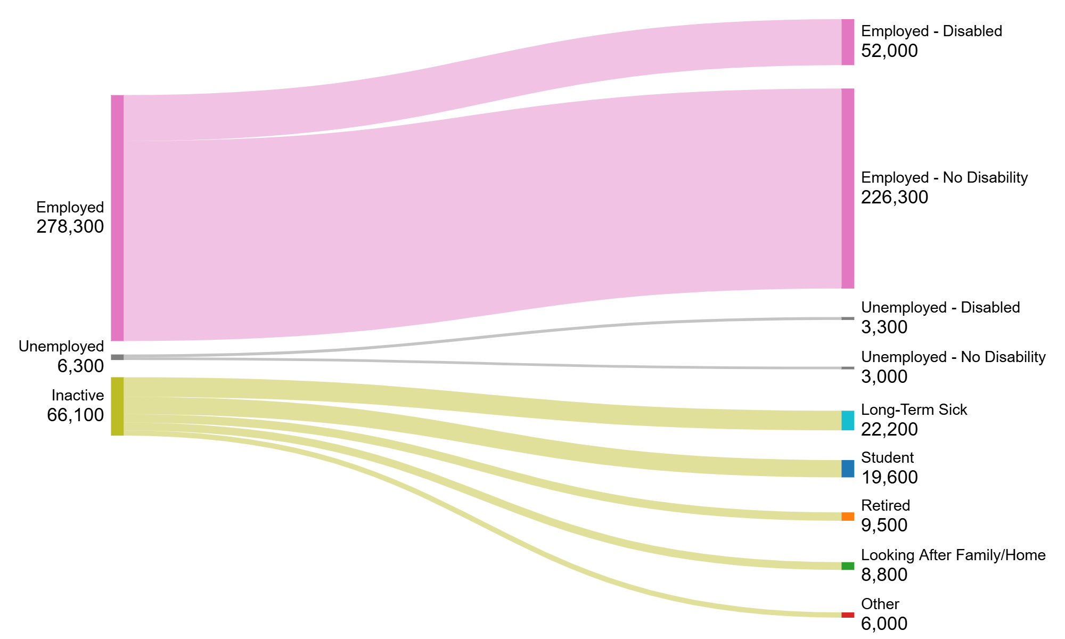
Get Worcestershire Working : Labour Market Groups
Data refers to point in time and not flows. Intended to show different labour market groups and respective sizes. Reflects most recent available data as of April 2025.
In Worcestershire, 59.6 of people are of working age. Around 80.3% are in some form of employment, albeit that 3.1% are claiming benefits of some kind.
Alongside this Worcestershire has an inactivity rate of 18.8% compared to West Midlands at 22.5% and England at 21.1%

Slide 5
Worcestershire has currently between 79.4% employment rate

Slide 6
Employment across Worcestershire
Quick analysis , shows rate of 79.4% employment rate with slightly less females than males albeit significantly above national averages.
Lesser rates of over 50s employment than the 25-49 age group

Slide 7
Worcestershire Labour Market Analysis
Economic Inactivity
18.8% of residents are inactive in Worcestershire
Largest number is those aged 50-64 at 26’800 (23.8%) , but this should be considered with 14% retired
Unemployment
Unemployment is at 3.2%
However, Youth unemployment is higher at 5.1%
NEET Rates
624 young people are NEET in Worcestershire ( May 2025)
Vacancy Rates
Pay
46% of the population have qualifications above Level 4
Employees who work in Worcestershire earn £72 less per month than the UK average
Workplace average earnings in Worcestershire are £1157 less than average earning per resident annually
Since 2023, Worcestershire sees at any time around 10’000 vacancies
40% of the population have highest qualifications at Levels 2 and 3
Largest number of vacancies is in Healthcare
Youth Employment in Redditch are at all time high of 7%
Rates of inactivity due to long term health condition is 5% lower in Worcs than England and 4 % in WM
Of those with no qualifications , 44% are inactive
Over 50s unemployment over the last 12 months has grown by 250 people
Health and Employment
Highest rate of conditions impacting work are Mental Health conditions
Estimates show that 2.3% of the workforce ( had a day off last week
NEET Rates are influenced by a variety of factors from :
Fit notes – 2850 a week across H&W with rates increasing
Provision availability
Health provision
Availability of careers advice
Transport accessibility
6% of working age population have no qualifications
Qualifications
83% of the businesses who responded to the HW Chamber Salary survey attempted to recruit in last 12 months
66% of those experienced challenges in recruitment
Young people in Care and with EHCP have significantly higher rates

Slide 8
In summary – page 1
Wages and Productivity
Worcestershire’s productivity levels lag behind those of neighbouring regions. Key contributing factors include:
A dominance of smaller employers with limited capacity for high added value.
Insufficient succession planning and upskilling opportunities. (leading to higher salaries for greater output)
A significant proportion of residents with low qualification levels.
Young People and Skills
The county faces growing challenges with youth engagement:
An increasing number of young people have low qualifications, limited or no work experience, and are not engaged with support services.
Re-engagement provision is limited.
Entry-level opportunities are declining, particularly in sectors like retail, hospitality, business administration.
The apprenticeship market remains highly competitive, further limiting access for those with fewer qualifications.

Slide 9
In summary – page 2
Health and Labour Market Exclusion
Health-related barriers are a major factor in economic inactivity:
Worcestershire’s rate of labour market exclusion due to health is over 5% higher than the national average.
Mental health is a significant concern:
Over 33% of young people accessing youth hubs report wellbeing needs.
46% of Employment Support Allowance claimants cite mental health as a primary issue.
More than 20,000 fit notes have been issued, with mental health as the leading cause, followed by musculoskeletal conditions.
Economic Inactivity and Regional Variation
Economic inactivity is closely tied to health and demographic trends:
In Redditch, health and caring responsibilities are key drivers.
In Malvern Hills, Bromsgrove, and Wychavon, a larger proportion of the population is approaching or at retirement age, contributing to higher inactivity rates.

Slide 10
In summary – page 3
Employer Challenges
Employers across the county report difficulties in recruiting the skills they need. However:
Many lack long-term strategies for workforce development and have low investment in training.
There is limited investment in succession planning and staff upskilling, which hampers both productivity and resilience.
Investment in automation and digital products are lower than national and regional. This could relate to the large number of micro employers, not having the means to invest.
Employers report not being able to find the skills they need in the current Worcestershire education footprint, which is likely driven by diversity of need.

Slide 11
Current landscape - positives
Positives
Relationships are strong in Worcestershire – NHS , DWP , Local Government, Employability Providers, Schools, FE and Training/Apprenticeship Providers.
Focus on Young People has supported to understand the challenge , whilst resource has been limited, outcomes have been strong across Youth Hubs, Apprenticeships and Early Careers work.
Worcestershire understands the challenges but our ability to address is always limited by size and funding
Business engagement is good and we have strong mechanisms to continue to develop in this space
Worcestershire hosts three committed FE colleges with a variety of specialisms which provide a good spread of curriculum, but the focus is lacking in adult provision
Data suggests we are within the 80% employment rate but there are pockets of challenges to address
Worcestershire’s HE provision matches the key sectors of our economy – Education, Healthcare and Local Government

Slide 12
Current landscape – challenges and gaps
Challenges
Limited Funding, only touching sides of challenges creating limited ability to address all issues, creating silos, gaps and duplication in agendas
Multiple front doors and confusing access points
Gaps
Joint messaging – Each partner is communicating with employers in a piecemeal way through their lense.
Need more delivery in localities, as the local challenges are different and ability to flex support is limited
Fragmented system – Health , Public Health, LA , DWP etc
Short term funding and programmes
SME Landscape of employers , lots of asks and lots of employers !
High demand for limited services i.e. Health
GDPR used as a barrier to join the system up around the individual.
Challenges in accessing transportation and its cost.
Careers advice availability and quality varies
Education engagement offer for NEETs is variable
Further integration of services to aid identifying those inactive residents
Holistic practices or need for more social prescribing from health professionals.
Need for more holistic and intensive support
Limited provision – see above
Lack of Adult Skills offer to upskill in county and lack of desire/incentive to upskill
Consideration of inactivity on a long held Worcs economic policy pursuing high skilled / high paid jobs.
Understanding of skills needs of employers in the county
Multiple “support” systems between partners fragmenting support landscape
Need more education provision in certain vocations.
Employers not having the capacity or resources to support the individual employee.
Notes:
Ie Community Services Directory and Joy App
Challenges – Funding is Limited _ worse than ever at mo. Not touching sides , we have 66100 inactive people , with 22000 because of health and a 5 yr programme that will help just over 2000.
Leads to issues – silos of provision, protectiveness over finance etc
Same with provision -not enough funding…..
Its hard to access what you need , you get passed around…
System is fragmented
What funding we have is short term and in skills this is really challenging and often leads to those easier to help getting help
Lots of SMEs
High demand for services
GDPR sharing information to allow us to be more effective is an issue
Transport and the cost of it
Multiple support systems – showing that fragmentation – Joy App and Community Directory good example
Need more education – more apprenticeships – there is demand and we cant meet it
GAPS
One common message from partners
Employers are challenged to resource and support employees then throw health conditions into the mix
Challenges in pockets – small need , very intensive work , high cost
Careers advice quality is varied
Education offer for NEETs – a gap
Integration of services to better identify – no wrong door
Lack of adult skills offer in county and a lack of “desire “ found in LSIP
Need more understanding of future skills needs
Economic policy and the interaction

Slide 13
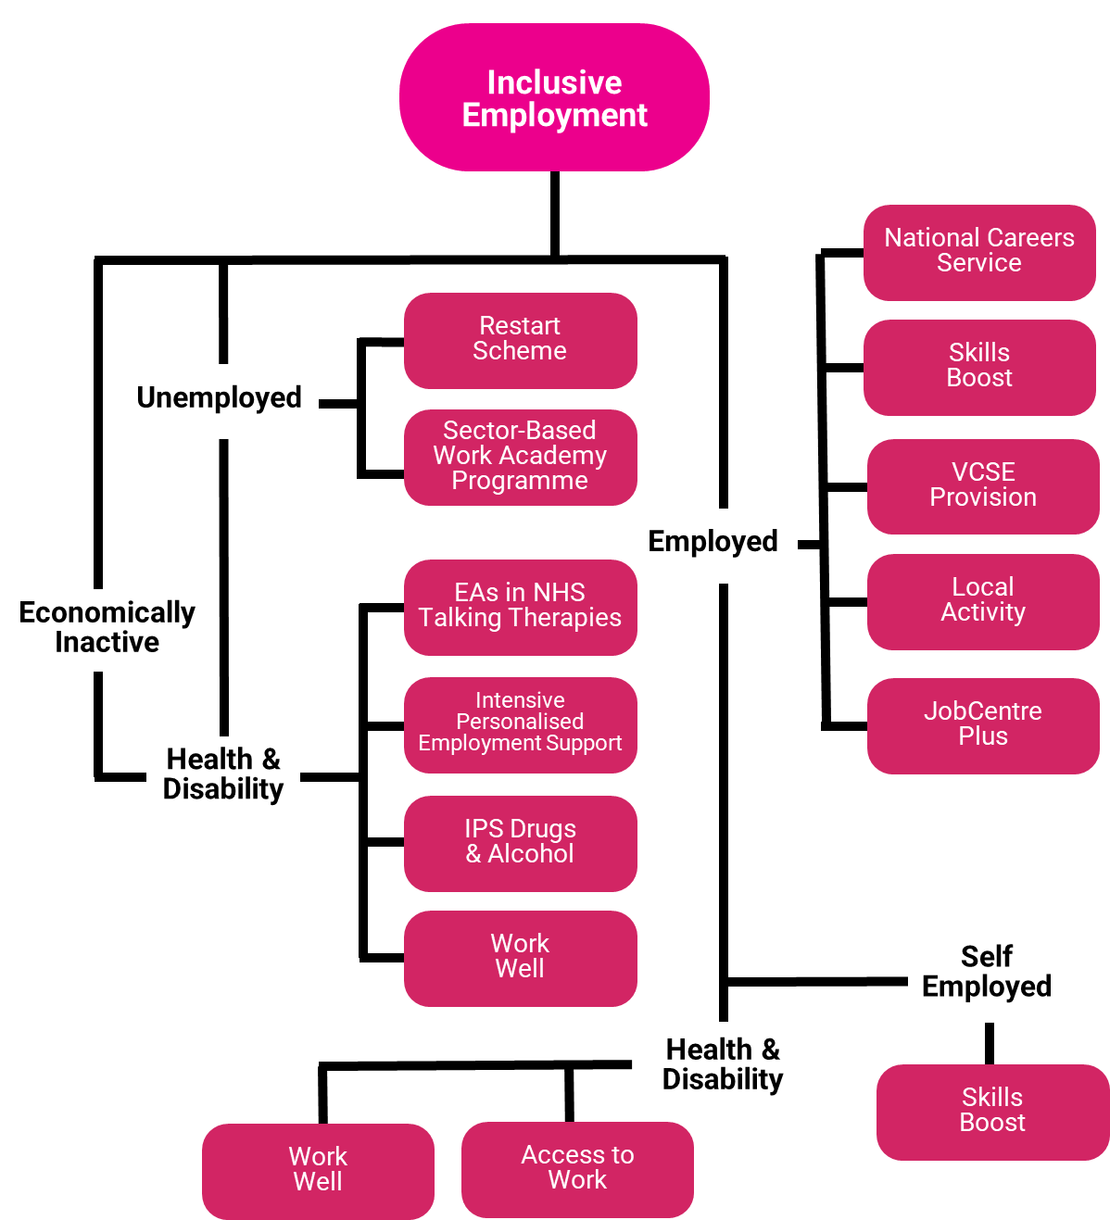
Current Landscape of Support

Slide 14
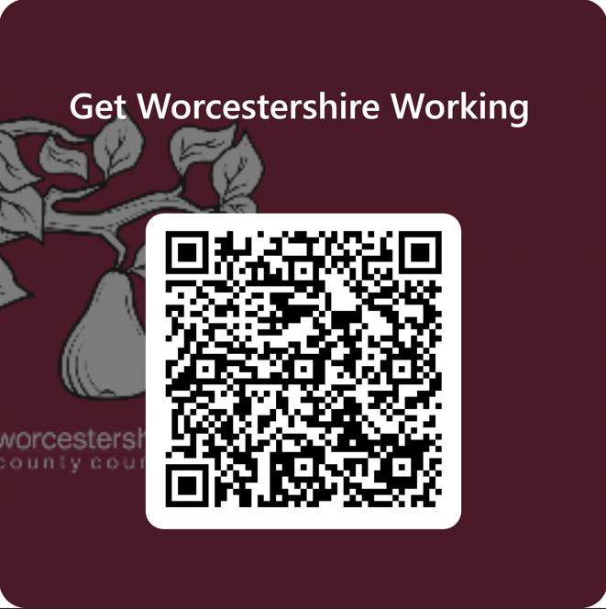
Start your Response
To assist us with your thoughts please scan the QR Code or view the Consultation Questionnaire through the following link :-
Get Worcestershire Working

Slide 15
Questions 3-6 within Form
Is this your experience of the Worcestershire employment support system?
2. Logic chains and assumptions – Do you think any of these are incorrect assumptions or draw the wrong conclusions from the data / analysis?
3. What is missing from this assessment?
4. What is your role in landscape? What action (s) would you be prepared to commit to, to make the situation better?

Slide 16
Priorities
Short Term – 12 – 24 months
Long Term – 24 months – 10 years

Slide 17
Short Term Priorities
Youth Employment and Transitions
Inclusive and Healthy Workforces
Skills Development and Adult Learning
Infrastructure and Accessibility
Employer and System Integration

Slide 18
Short Term Priorities – The Detail 1-2
1. Youth Employment and Transitions
Focuses on supporting young people through education-to-work transitions and early career development.
Young people 16–24 – Engage and move into work – Deliver UKSPF/Youth Hubs
Provide greater levels of transition support at key transition points (e.g., Post-16 and Post-18) for all young people.
Focus on delivering the Modern Work experience programme for young people
Continue to develop system partnerships to improve value for money and outcomes for residents – e.g. NEET strategy
2. Employer and System Integration
Focuses on embedding services within existing structures and improving coordination.
Embed the Jobs and Careers services into DWP sites ,offices and other locations.
Develop the information available to residents and employers around services within the county (e.g., WGH and Community Services Directory)
Continue to develop system partnerships to improve value for money and outcomes for residents

Slide 19
Short Term Priorities – The Detail 3-4
3. Inclusive and Healthy Workforces
Aims to create supportive, accessible, and inclusive employment environments.
Inclusive Workforces – Grow the numbers of healthy and inclusive workplaces for employees in the county
Embed focus on supporting individuals with health conditions and disabilities through national programmes i.e.. Connect to Work
Increase the levels of Disability Confident Employers in Worcestershire.
Deliver the WorkWell Vanguard for Worcestershire, secure funding for 2026 onwards
Improve visibility and awareness of support from health services to employment services
Understand the physical health touchpoints where residents where support could be offered support i.e.. (e.g. Fit Notes)
4 . Skills Development and Adult Learning
Targets upskilling and reskilling the adult population to meet economic needs.
Adult Skills Offer – Launch “Think Skills Worcestershire” & work with colleges to deliver a greater training offer
Continue to grow the DfE Skills Bootcamps programme and successful outcomes into employment
Embed the Local Skills Improvement Plan into Worcestershire and gain greater understanding of workforce needs
Develop the countywide Talent and Skills Pledge for Worcestershire

Slide 20
Short Term Priorities – The Detail 5
5. Infrastructure and Accessibility
Addresses physical and systemic barriers to employment.
Transport Review – Use findings to understand barriers to entry for potential employees and access to industrial estates across the county
HM Government Reforms – Deliver and support reforms from Government whilst continuing to consider agenda and impacts, embed into workstreams across partners i.e. Youth Employment Guarantee, Local Government Reforms, ICB Clustering, DWP Reforming of Jobcentres etc.
Create new approach to funding and procurement - Seek Funding for 2026 and beyond, whilst creating new structures for partnership approach, improving integration into geography and reduce duplication, silos etc.

Slide 21
Proposed Long Term Priorities - overview
Focus on the creation of Holistic and Integrated Support Systems
Drive efficiencies in practice through standardisation and system changes
Build greater employer engagement and workforce development
Continue to drive the quality of Careers and Employment support to young people
Develop an Inclusive Economy and specific tailored approaches to Employment and Skills
Strengthen levels of skills within our Adult population
Seek funding opportunities for Worcestershire to grow its skills and employment offer
Create understanding of the impact of Good employment on Health of residents

Slide 22
Proposed Long Term Priorities 1-2
1. Focus on the creation of Holistic and Integrated Support Systems - Strategy
Develop Front Door access for residents and employers around skills and employment support that builds holistic assessments
Cut through system – Work towards building a holistic view of a person, identifying support needs and services accessible and accessed using information from all service partners
Gain a better understanding of system interactivity and explore solutions – Recognise how challenges in related systems contribute to employment difficulties
Minimise duplication and deliver value for money through commissioning across organisations
2. Drive efficiencies in practice through Standardisation and System changes - Operation
Reduce variance in processes across the county to standardise triage across commissioned programmes and in certain workstreams
Focus on aligning the Social Value Act through Public Sector in Worcestershire
Use our system data across partners to better inform service need
Build collective solutions to improve outcomes around employer engagement, service directories, careers support etc.

Slide 23
Proposed Long Term Priorities 3-4
3. Build greater employer engagement and workforce development
Deepen levels of Employer Engagement in Skills Programmes – Explore Worcestershire Growth Hub and create an Employer Skills Hub
Improve long-term Workforce Planning in Worcestershire
Ensure the Local Skills Improvement Plan creates improved understanding of local skills needs from employers
Tilt current Inclusive programmes to create Employer charter around Fair work and raising skills and productivity levels
Ensure the Growth and Skills Levy is maximised in Worcestershire
Continue to drive Apprenticeship Growth within the county’s employers
4. Continue to drive the quality of Careers and Employment support to young people
Increase the focus and embed programmes to reduce NEETs and Youth unemployment in Worcestershire
Careers Advice – Improve quality and quantity of advice across the system assuring the Worcestershire dynamic
Continue to commit to delivery of the Careers and Enterprise Company Programme, improve quality of delivery across region around LMI and Careers advice

Slide 24
Proposed Long Term Priorities 5-6
5. Develop an Inclusive Economy and specific tailored approaches to Employment and Skills
Create an Inclusive Economy – Healthy and inclusive businesses where economic policy lowers inactivity
Focus on Localities, identify areas of disadvantage and create innovative solutions to locality-specific challenges
Focus on disadvantaged groups and understanding the needs and demand around employability support
Continue to focus on inactivity and delivery of key initiatives
6. Strengthen levels of skills within our Adult population
Focus on Over 50s and reskilling for employed and unemployed
Develop Adult Skills offer within county
Support HE/FE Colleges and Independent Providers to develop provision through capital/revenue funding to meet local skills needs

Slide 25
Proposed Long Term Priorities 7-8
7. Seek funding opportunities for Worcestershire to grow its skills and employment offer
Seek Funding to deliver against challenges faced in Worcestershire
Work with Skills England, look for opportunities to develop key sectors within Worcestershire
8. Create understanding of the impact of Good employment on Health of residents
Improve our understanding of the Health contribution on Economic Development and the need for services and enable action to be taken where health drivers impact.
Collaborate with wider health-based stakeholders around the role of employment on health i.e. Primary Care Networks , GPs etc.
Create resident-based campaigns across partners around the impact of good employment on health
Provide early health and employment support interventions to prevent individuals leaving work
Ensure Worcestershire workplaces are health promoting environments and that people are supported with health conditions and disabilities.

Slide 26
Questions
Anything missing ?
Do you agree with these priorities ? What would you add or change ?
What do you think will make the most difference? How would you order them ?
What actions are needed to create this change ?

Slide 27
Questions – Questions 7 – 10 within form
Do you agree with these priorities ?
What would you add or change ?
Which priority do you feel will make the most difference to Worcestershire and its challenges ? And why ?
What actions are needed to support the priorities and system change? Which action would you prioritise?

Slide 28
Next Steps
- Following your feedback WCC will amend the priorities
Public Stakeholder consultation will finish on the 31st July
Need to get as MUCH feedback as possible from stakeholders – please share messaging and help us to get this feedback , build into any event messaging you have etc.
Aim to publish in September following internal Governance and final Sign offs from ICB and DWP by September 30th for submission to HM Government .
Thank you for participating and giving your views. If you want to discuss further please contact at GBW@worcestershire.gov.uk

Slide 29
Thank you
jgibbs@worcestershire.gov.uk

