Slide 1


Year 9 Review
Student Accessible Information

Slide 2
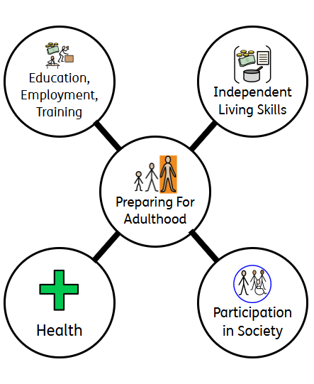
Slide 2

Slide 3

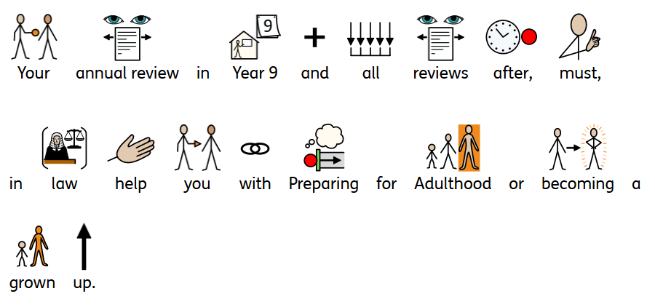
Slide 3

Slide 4




Slide 4

Slide 5

Slide 5
https://www.worcestershire.gov.uk/council-services/schools-education-and-learning/send-local-offer

Slide 6

Slide 6

Slide 7


Slide 7

Slide 8

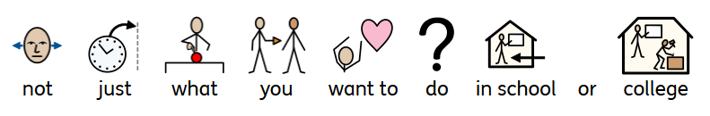
Slide 8

Slide 9



Slide 9

Slide 10




Slide 10

Slide 11

Slide 11

Slide 12


Slide 12

Slide 13


Slide 13

Slide 14




Slide 14

Slide 15


Slide 15

Slide 16

Slide 16

Slide 17


Slide 17

Slide 18



Slide 18
01905 768153 for Worcester
or
01432 260955 for Hereford.
sendiass@worcestershire.gov.uk
or
sendiass@herefordshire.gov.uk

