Slide 1
'In the moment thinking’ Two strategies for children with SEMH Needs
Sofia Hussain

Slide 2
Reactive Strategies for Regulation – Early Years Conference
Dr Sofia Hussain and, Early Years Educational Psychology Group Senior Educational Psychologist Special thanks to Mary Stephens and, Educational Psychology Team (Inclusion Support Services)

Slide 3
We would appreciate your views continued 1………
What has been the most concerning or biggest ‘red’ behaviour you have seen in children?
How does this make you feel as a practitioner?

Slide 4
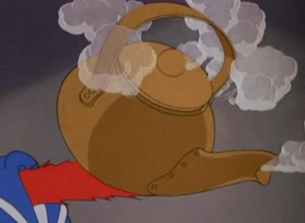
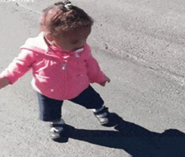
Some of the
ways you
may feel. ..
Do you know what your colleagues need?
Do you know what YOU need?
Could you complete this:
If 'this' happens with 'child_X,_I may feel ‘1 and/or 2’ and I need for ‘do this’ 'this' or 'that' - can 'peer Y'
running away from my
problems

Slide 5
Try Not To: What should we be avoiding?
Getting 'too close' or ‘big’ or ‘crowding
Ignoring completely
Assuming they're still chronological age and using complex language
Trying to handle this by yourself
Not logging the incident and analysis
Preventative:
Risk assessments- environment & staffing. Plan the 'escape route' to the sensory
room ahead
Plan the fiddle or soothing box/distractors/transition toys ahead
Have a routine for quiet transition to other spaces for all the children
Log functional behaviour assessment
Identify supports you need {complete the statement on slide 6.
Reactive: MAINLY
Careful tone/language/body...

Slide 6
We would appreciate your views continued 2………
1. What has been the most concerning or biggest 'red' behaviour you have seen in children?
2. How does this make you feel as a practitioner?
3. What do you think will help you 'in the moment'?
4. What do you think will help the child 'in the moment'?

Slide 7
Philosophy: Low level arousal approach
Ethos: Practical, child-centred and non- confrontational.
2 Principles: Recognise we may inadvertently trigger a stress response and responses to behaviour should be trauma informed.
Components: Reducing demands, avoiding triggers and provocative non-verbal behaviours. Sounds simple but can be very challenging!

Slide 8
C …. A …..
Communication:
Keep speech to a minimum. Visuals will be easier to process.
Keep any speech used calm, slow and simple. Use one or two words at a time.
Don’t argue.
Don’t talk about the person to others in the room.
Atmosphere:
Remove the trigger (s)
Remove other people
Create quiet, calm and comforts
Offer distraction and a way out of the situation
Use a visual to offer an activity or object

Slide 9
L…. M…..
Me:
Keep your facial expressions relaxed and neutral
Don’t share
Keep a relaxed posture
Leave your hands open and your arms unfolded
Keep a safe distance
Listen
Allow time to recover and calm
Don’t make any demands
Allow rest as the person may be exhausted
Review and record what went well and what should be changed

Slide 10
We would appreciate your views Continued 3………
1. What has been the most concerning or biggest 'red' behaviour you have seen in children?
2. How does this make you feel as a practitioner?
3. What do you think will help you 'in the moment'?
4. What do you think will help the child 'in the moment’?
5. From today, what do you think has resonated with you most?
6. What one or two things might you try moving forward?
7. How could we improve the session?
8. What should we keep from this session, if we do it again?

Slide 11
Thank you, links and references
Please also see below for a list of preventative and practical strategies
Early Years Inclusion Webcasts from the Early Years Inclusion Team and Complex
Communication Needs Team: Early Years Webcasts
References
Broad Approaches that Support the Autistic Learner (middletownautism.com)
Careknowledge (2018). The Low Arousal Approach: A Practitioner's Guide.
3-Positive-Behaviour-Support-Guidelines.pdf (lancashiresafeguarding.org.uk)

