Slide 1



Provider access legislation
Update December 2022

Slide 2
The role of The Careers & Enterprise Company and the Local Careers Hub

Slide 3
PAL in Context
To ensure the provider access legislation is implemented in a meaningful way by schools we have tied it in with our narrative on promoting all pathways.
Promoting all pathways enables Careers Leaders and key staff to ensure that young people and parents & carers are supported to develop knowledge and understanding of all available routes at key transition points, allowing young people to make informed and equitable choices about their next step.
The provider access legislation builds on Benchmark 7 and adds new specific requirements for schools. It is a key mechanism to further help learners understand and take-up, not just apprenticeships, but wider technical education options such as T-Levels and Higher Technical Qualifications. ​
For schools already promoting all pathways well and delivering strongly on Benchmark 7, the provider access legislation will not be a big change for them. For others it will be a trigger for reconsidering their approach and ensuring providers representing a range of pathways are included in their careers programme.

Slide 4
The role of the CEC and the Careers Hub…
The Careers & Enterprise Company will support schools and providers to understand, deliver and record compliance with the new requirements as part of their wider careers' programmes.
This will include support at a National, Careers Hub and Institutional Level.
This should be seen as a part of continual wider improvement in Careers Programmes – not a standalone initiative

Slide 5
The role of the CEC and the Careers Hub
The CEC want to be clear on the role we are asking Hubs to take and to ensure that activity supports an institution's ability to comply with PAL.
SCHOOLS are responsible for compliance – CAREERS HUBS ARE NOT
Providers are the suppliers of encounters,
The legislation assumes a sufficient supply is available. Ultimately if providers don’t supply institutions can’t comply
The CEC and Careers Hub role are not to be the PAL police – we are focused on providing support and offering solutions, which may not be taken up. Where necessary DfE will police the legislation
The legislation isn’t intended to be the route for broad academic vs technical frustrations or historic local issues – the legislation relates only to the PAL expectations
This process hasn’t been implemented as a potential whistleblowing service

Slide 6
The role of the Ofsted
Ofsted’ s school inspection handbook sets out strengthened expectations with respect to careers education, information, advice and guidance (CEIAG), and specifically the provider access legislation.
Ofsted’ s grade criteria set out the expectation that a school with 'good' personal development will meet the requirements of the provider access legislation. Where this is not the case, inspectors will state this in the published inspection report. They will consider what impact this has on the quality of CEIAG.
The support and concerns stages of the ladder must be moved through before a complaint can be raised, a complaint should not therefore be a surprise to the school and to an extent will be willfully created by them
If the school continues to be non-compliant, an official or a minister from the Department for Education will write to the school reminding them of the requirements of the duty and will state a date that the school will need to comply by to avoid moving to formal intervention. The letter will state that the senior leadership team and/ or the governors should undertake Careers Leader training (depending on the circumstance, the school may have to fund the training).
Ultimately if still non-compliant the use of the Secretary of State’s intervention powers will be deployed, under Section 496 and 497 of the Education Act 1996, to require appropriate remedial action to be taken.

Slide 7



School Mandate

Slide 8

Creating the conditions for success:
School Mandate
The provider access legislation is a new law that is coming into force in January 2023. It specifies schools must provide at least six encounters for all their students:
Activity mandated for each registered pupil not just select groups:
The new legislation will become a key mechanism to further help learners understand and take-up, not just apprenticeships, but wider technical education options such as T-Levels and Higher Technical Qualifications.
Underpinning statutory guidance is inline with the final guidance from DFE due to be issued w/c 12th December 2022
Two in Years 8 and 9, two in Years 10 and 11 (which are mandatory for all registered learners to attend)
Two in Years 12 and 13 (which it is mandatory the school offer but optional for learners to attend)

Slide 9
Creating the conditions for success:
School Mandate
Two encounters for pupils during the ‘first key phase’ (year 8 or 9) that are mandatory for all pupils to attend, to take place any time during year 8 or between 1 September and 28 February during year 9.
Two encounters for pupils during the ‘second key phase’ (year 10 or 11) that are mandatory for all pupils to attend, to take place any time during year 10 or between 1 September and 28 February during year 11.
Two encounters for pupils during the ‘third key phase’ (year 12 or 13) that are mandatory for the school to put on but optional for pupils to attend, to take place any time during year 12 or between 1 September and 28 February during year 13. Schools should encourage all pupils to attend the encounters, however, optional attendance for older pupils recognises that, while many 16- to- 18-year-olds will benefit from finding out more about post-18 technical options, some will be in the sixth form having made a firm decision to pursue their chosen pathway.
*You cannot count two encounters with the same provider in the same phase, this would only count as one

Slide 10
Criteria
Schools must ensure the provider of technical education or apprenticeships provides information to pupils that, as a minimum, includes:
information about the provider and the approved technical education qualifications or apprenticeships that the provider offers,
information about the careers to which those technical education qualifications or apprenticeships might lead,
a description of what learning or training with the provider is like,
responses to questions from the pupils about the provider or approved technical education qualifications and apprenticeships
Failure to deliver the 4 x encounter elements listed above would mean that any encounter delivered would not be classed as “Meaningful” and would not meet the requirements of the PAL.

Slide 11
Creating the conditions for success:
School Mandate 1
  Additional Information for Schools
  There are a number of key points which schools should be aware of as part of the wider legislation to support their engagement with providers.
ALL 6 x Encounters MUST happen for a reasonable period of time during the standard school day
  No single provider can deliver both encounters during any SINGLE PHASE of delivery within a school.
Schools SHOULD offer training providers ample time to cover the mandatory elements they are required to deliver in order to make the encounter meaningful
Expectation that most provider encounters to be face-to-face but encouragement of a blended approach with the use of virtual engagement where access may be an issue.
Note - Encounters no longer have to be at the school site

Slide 12
Creating the conditions for success:
School Mandate 2
  Additional Information for Schools
  There are a number of key points which schools should be aware of as part of the wider legislation to support their engagement with providers.
Schools must provide six encounters with providers of ‘approved technical education qualifications or apprenticeships’ or someone representing them if they “are particularly well placed to engage and inform pupils about the options available”
  The school should not arrange any encounter which might limit the ability of pupils to attend
All pupils should have the same opportunities for meaningful provider encounters.
Some pupils with special educational needs and disabilities, looked after children and pupils from Gypsy, Roma and Traveller communities may need additional support to access provider encounters

Slide 13
Creating the conditions for success:
School Mandate 3
  Additional Information for Schools
  There are a number of key points which schools should be aware of as part of the wider legislation to support their engagement with providers.
  Schools have NO obligation to allow EVERY training provider access to deliver encounters within school as long as they meet the 2 x encounter requirement for each of the delivery phases
Schools should consider geography when selecting providers to delivery PAL encounters. Taking in to account where students can realistically travel to should be a factor when planning PAL activity.
Schools will be asked by the local careers hub to share details of any providers who are not willing to deliver an encounter during the KS3 phase of delivery
Each schools assigned Enterprise Co-Ordinator will regularly discuss with each school their planned PAL activity and provide support where appropriate to ensure legislation is being met.

Slide 14
School Provider Access Policy Statement
Every school should review their arrangements for provider access in line with the changes to the legislation and prepare a new policy statement setting out the circumstances in which education and training providers will be given access to pupils.
This statement, and wider careers programme, will need to be updated with information about how the school will meet the new legal requirement to put on six provider encounters, prior to the new duty coming into force in January 2023.
A sample statement will be included within the updated guidance

Slide 15
School Provider Access Policy Statement.
The policy statement must be published, either as part of or alongside the wider careers programme and should be made available on the school website.
The DFE expect a policy statement to be published for each academy within a multi-academy trust.
The school may revise the policy statement from time to time and we recommend that this is done annually, by the Careers Leader, and agreed with the governing body.
The purpose of the statement is to set out how the school intends to comply with the minimum requirement to provide six encounters and the opportunities for providers to visit and to explain how requests from providers will be handled.

Slide 16
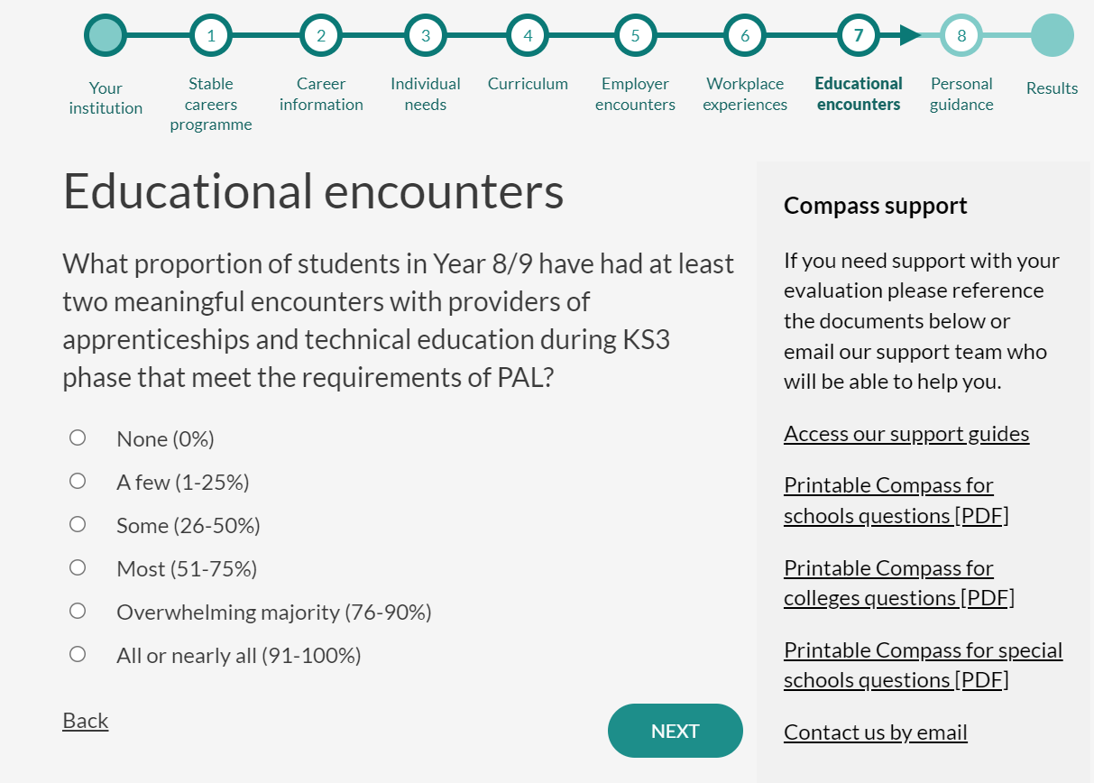
Creating the conditions for success:
School Mandate…
Recording and Evidencing requirements of PAL
Additional (unscored) questions have been added to the Compass evaluation tool under Benchmark 7 to allow schools to record and evidence compliance against the new legislation.
Questions will cover activity over all 3 x phases of delivery
Details of the providers undertaking the encounters will also be recorded
Questions will be tailored to the institution's details. For example, schools without a 6th Form will only be asked questions about KS3 and KS4 and Middle Schools will only be asked about KS3

Slide 17
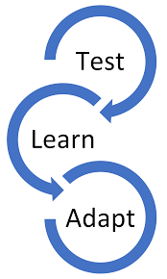
Creating the conditions for success:
School Mandate..
QUESTION:
Can we provide a list of example activities which schools could consider facilitating with training providers which would count as a meaningful PAL encounter?
RESPONSE
Over time the wider careers hub network and the CEC will be collating some examples of Best Practice based on feedback from our network of schools and TPs but during the initial stage of delivery we will be following the “Test / Learn / Adapt” style approach”

Slide 18
Provider Mandate

Slide 19
Creating the conditions for success:
Provider Mandate
  How is this different to the Baker Clause?
  It sets out new requirements on the number of encounters, mandates that all learners must attend, requires that they take place during the normal school day and specifies what these encounters need to contain as a minimum for example the opportunity for pupils to ask questions.
  When delivering an encounter within school training providers should ensure the following information is shared with students:
  information about the provider and the approved technical education qualifications or apprenticeships that the provider offers
  information about the careers to which those technical education qualifications or apprenticeships might lead
  a description of what learning or training with the provider is like
  responses to questions from the pupils about the provider or approved technical education qualifications and apprenticeships

Slide 20
Creating the conditions for success:
Provider Mandate
  Additional Information for Training Providers
  There are a number of key points which Training Providers should be aware of as part of the wider legislation to support their engagement with schools.
  Providers should encourage schools to allow them ample time to deliver the mandatory elements of an encounter to ensure it is meaningful
  Providers are encouraged to develop a range of activity offers covering ALL 3 key stage delivery phases.
  Schools have the choice to select which Training Providers they would like to deliver encounters to their students during each phase of PAL delivery
  Providers should not raise any school related PAL concern based solely on NOT being granted access to deliver within any individual school as the school may already have planned their PAL activity.

Slide 21
Creating the conditions for success:
Provider Mandate.
  Additional Information for Training Providers
  There are a number of key points which Training Providers should be aware of as part of the wider legislation to support their engagement with schools.
  Feedback will be obtained by the Careers Hub, via the TPA, on any challenges being faced by Training Providers surrounding the delivery of PAL encounters within schools.
  Training providers have the right to turn down a request from a school if they do not have the capacity to deliver the requested encounter.
  Training providers should not turn down a request to deliver an encounter within a school based on the student key stage / school type / student type they are being asked to deliver to. E.G. Key Stage 3 students / Middle School / SEND

Slide 22
Creating the conditions for success:
Provider Mandate.
  Additional Information for Training Providers
  Using examples of local training providers an individual schools PAL delivery could look something like this during a single academic year:
PHASE | Encounter 1 | Encounter 2
Phase 1 -Years 8 / 9 | HOW College | HWGTA
Phase 2 - Year 10 / 11 | MGTS | HOW College
Phase 3 - Years 12/13 | Kidderminster College | TDM
Phases 1 & 2 – Mandatory for ALL Registered Students to attend
Phase 3 – Mandatory for school to offer but NOT mandatory for students to attend
  Schools will have the option to offer more than the minimum of 2 x encounters per phase should they wish to ensure ALL registered students receive the required encounters or provide encounters based on student interest.

Slide 23


Our local delivery plan

Slide 24
Agreed Actions

Slide 25


Information for Training Providers
Develop a web page on the hubs Skills 4 Worcestershire website which provides direct links to each hub member schools Provider Access Policy.

Slide 26

Document for Schools
Development of a directory which provides Schools with an overview of the individual training provider offers and contact details
Release Date: TBC

Slide 27

Feedback
The Careers Hub will look to develop mechanisms to capture and collate feedback on PAL encounters delivered within schools.
Potential options –
1) Creation of process to capture feedback from schools on their ability to delivery PAL encounters and any gaps in local delivery opportunities.
2) Create mechanism, through TPA, to capture feedback on the challenges providers may face while delivery PAL encounters within schools.

Slide 28

Monitoring Delivery
Local CEC delivery team will continue to meet with school Careers Leads twice per term
1st half termly meeting will discuss / support any planned careers activity which will include any PAL related encounters being delivered.
2nd half termly meeting will discuss any actual delivery which has been undertaken, update via Compass or Compass+ and collate feedback and evidence to meet compliance.

Slide 29

PAL Related Enquiries / Issues
A direct PAL related email address will be set up and manned by the local hub delivery team to support any enquiries or concerns.
This will also meet the requirement to provide providers from outside of Worcestershire with the mechanism to enquire about local delivery opportunities and link with the TPA.

Slide 30

Performance Updates
Schools will continue to own the data generated by their Compass evaluation submissions. Individual school data can NOT be shared outside of the CEC and the local delivery team.
However, a collation of individual school data can be used to provide a picture of PAL performance across ALL hub member schools which will demonstrate activity taking place across Worcestershire.
These reports will be collated on a termly basis.

Slide 31

Agreed Actions…

Slide 32

Training Provider Association
The TPA will work directly with the Inspiring Worcestershire Careers Hub to obtain details of TPA members PAL activity offers.
These activities will then be shared directly with schools via the Training Provider Offer of Support Document.
The TPA will monitor and review activity offers of support on a regular basis.

Slide 33

Worcestershire Apprenticeships
On behalf of the TPA the Worcestershire Apprenticeships delivery team will develop a PAL activity offer which will help plug any gaps in delivery offered by the TPA across the 3 x delivery phases.

Slide 34
Training Provider Association…
The TPA will work directly with the Inspiring Worcestershire Careers Hub to develop a mechanism to capture and share feedback from Training Providers on the challenges TP’s are facing.
The TPA Management will share details of any school related issues highlighted by TPA members with the Inspiring Worcestershire Careers Hub delivery team.

Slide 35
Training Provider Association..
The TPA management will become the point of contact best placed to share, discuss and resolve any PAL related issues which are made by hub member schools which relate to their members

