Slide 1
Adults Provider Portal Training
June 2021

Slide 2
Housekeeping
Your hosts are Caroline Waldron, Project Manager and Abbie Bingham, Payments Supervisor
We are recording this session today
Please mute microphones and use the comments bar as we go through, we will revisit these queries at the end
General queries are welcome but we won’t be answering specific client related queries in this session – these should be sent to adultsproviderportal@worcestershire.gov.uk
Notes:
Presenting is new to me, so please be kind. Hoping there is no technical issues!
The main aim of today’s session is to address some of the queries that we receive, and hopefully make the Provider Portal work better for you

Slide 3
Agenda
Introduction and video
Tips and tricks for entering actuals and viewing remittances
Questions

Slide 4
Introduction
As you know WCC implemented the Provider Portal in November 2019
We hoped the new system would make it easier for providers as they could see a real time view of services, enter actuals directly onto the system; cutting out the need for paper invoices, and pay providers more efficiently. We also hoped it would have a positive effect on clients, as they would have more accurate bills
When the pandemic happened a decision was made from April 2020 that WCC would continue to fund certain services even if they could not be delivered due to Covid-19
We asked that you marked visits as ‘frustrated’ and enter a comment ‘due to CV’, this way we could monitor how many visits weren’t being delivered either due to clients isolating or your own staffing issues
Once we came out of lockdown we reversed that policy so from 3rd August 2020 (10th August for day centres) we were no longer funding these calls
Notes:
The portal is a view into our finance system. The social work system Las feeds into our finance system Controcc. The Provider portal is a view into Controcc. So if someone does not have a PO on LAS, it will not be showing on the portal

Slide 5
Terminology
So, what is the difference between frustrated and missed?
Frustrated is when we pay the provider, but we do not charge the client
e.g. during the first lockdown (April to August 2020) we asked that you enter calls as frustrated when the reason was Covid. Generally, this would also be used if not enough notice was given when a call was cancelled. An example would someone has gone into hospital, but they did not let the provider know in time
Missed is when we do not pay the provider and we do not charge the client
e.g. this would be used if a day centre was closed or if a care worker did not turn up for a visit. This would also be used if sufficient notice was given for a call to be cancelled for example if a client was in hospital
Notes:
It is really important that frustrated calls are noted correctly as if not they will result in a charge being generated and a bill sent to the service user. When the service user receives this we then have to come back to you to correct your actuals so that the bill can be reversed. This all takes time – yours and ours. If you have not confirmed your actuals by the time we bill, service users are billed on planned which can also result in incorrect billing and queries so again, timely accurate recording is key.
Frustrated due to Covid was only relevant in the period April to August 2020, anything outside of this timeframe would not be paid ‘due to CV’

Slide 6
Video
The way that we record these services depends on the service provided. This is covered in the video that is on our website (https://www.worcestershire.gov.uk/adultsproviderportal), and that we will revisit now;
https://youtu.be/SsnX8LvUmMs

Slide 7
Entering actuals
Our most frequently asked questions relate to entering actuals, or amending them. Entering actuals is covered in the video but when it comes to amending actuals backdated then we have an example on following page:

Slide 8
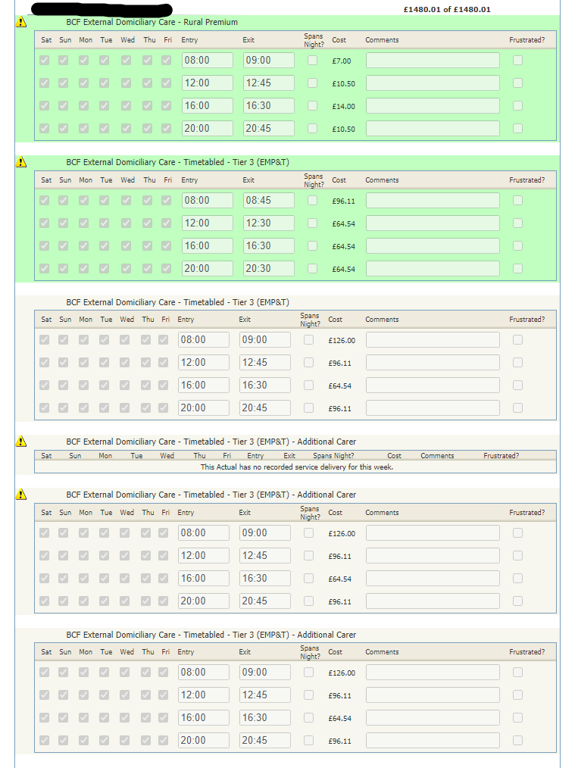
Example:
In this case a CPLI has been backdated, but actuals had been entered against the previous CPLI
To resolve this:
1. Remove the actuals relating to the deleted CPLI (with warning triangle)
2. Enter the actuals against the new CPLI (grey boxes without warning triangle) and add a comment e.g. backdated PO
3. No need to export/import
Warning triangle means it relates to a deleted CPLI
Notes:
Only amend the specific client

Slide 9
Other tips when entering actuals
If making backdated changes then it is important to only amend the specific client – as when you do the export/import process you are live in our system and it overwrites what has already been recorded. If you delete out actuals from other clients, then the money will be reclaimed
Actuals need to be entered regularly, not only does this ensure regular payment but means the information is available for client billing. We recommend weekly or fortnightly. If the actuals are only a fortnight behind then they will be up to date for client billing. The billing schedule is on the website under ‘Portal payments and support’
The deadline we have for submitting actuals is Tuesday evening, as the payment run is on a Wednesday
Notes:
you charge us, we bill the client

Slide 10
continued
Clients are billed on planned actuals so if no actuals have been entered, and someone has had no care e.g. if they are in hospital, they would be billed as if they had received all their care. This leads to more queries.
When completing the export/import process it is essential you also press the ‘update system’ button. If you are unsure whether you have imported one week, then you can do so again with no issues – this might be useful if you are missing a payment.
When doing the import if you get an error message then it is worth checking which client it is for by using the ID number, as the CPLI may have ended.
If you need to add any additional calls use ‘add row’ for a temporary change. Please note that if this is a permanent change it needs to be purchased by the social worker
Social work email addresses are on the website under Portal payments and support: purchase orders and contacts.
Notes:
CPLI = care package line item

Slide 11

continued
If someone does not appear on the actuals screen it means they do not have a current CPLI – please check the CPLI function on the portal:
Notes:
CPLI = care package line item, can be used to describe the purchase, I use it interchangeably for purchase

Slide 12
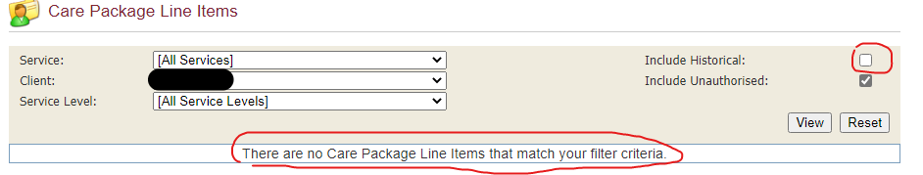
CPLI screen
To check if there is a current CPLI use this screen. Here is an example:
If it says there is no CPLI, then tick the historical button and ‘view’, and an ended service should come up
If the CPLI has been ended please go back to the social worker so a new one can be purchased.
You can enter actuals once it has repurchased – if backdated refer to my notes above

Slide 13
Remittance advices
Another frequently asked question is when a payment is due.
Generally if actuals have been imported by Tuesday evening then they will be picked up on the payment run on Wednesday. The remittance will then be showing on the Provider Portal on Thursday
Payment will be in your account the following Tuesday (subject to bank holidays)
The BACS remittance is emailed to you separately by the WCC Accounts Payable team (previously Liberata)
If someone is not on the remittance then this could be because they were not imported, or the payment has been suspended (this will show with a warning triangle). Payments are suspended if more than 10% of the current CPLI has been provided or if the CPLI has changed
If some clients have been paid but not others it could be that the export/import process was not completed, so it is worth importing again
Notes:
Suspended payments – let us know if something is suspended so we can check and release

Slide 14
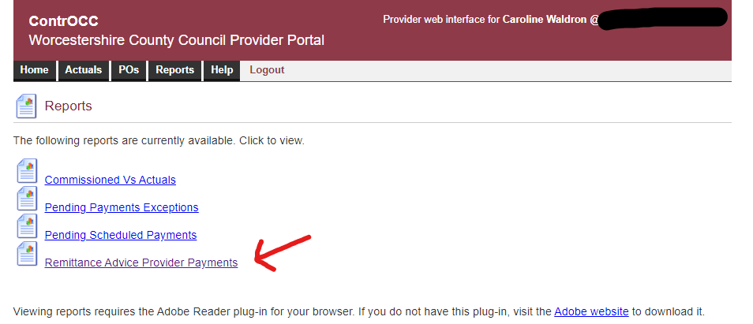
Remittance advice example

Slide 15
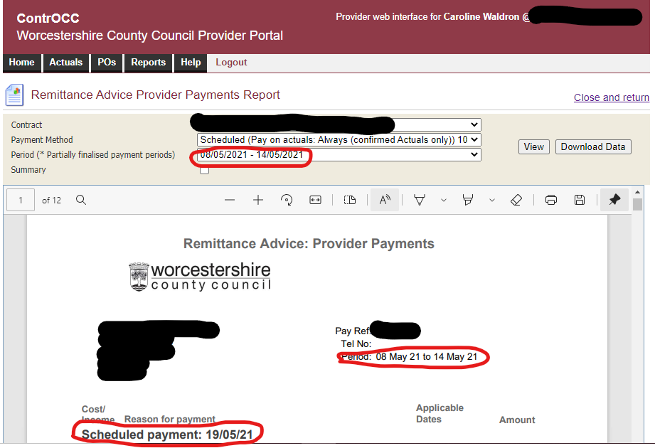
continued
Notes:
Period: check a week either side if you are looking for a historic payment
Scheduled payment: date of payment run, not date it’s paid

Slide 16
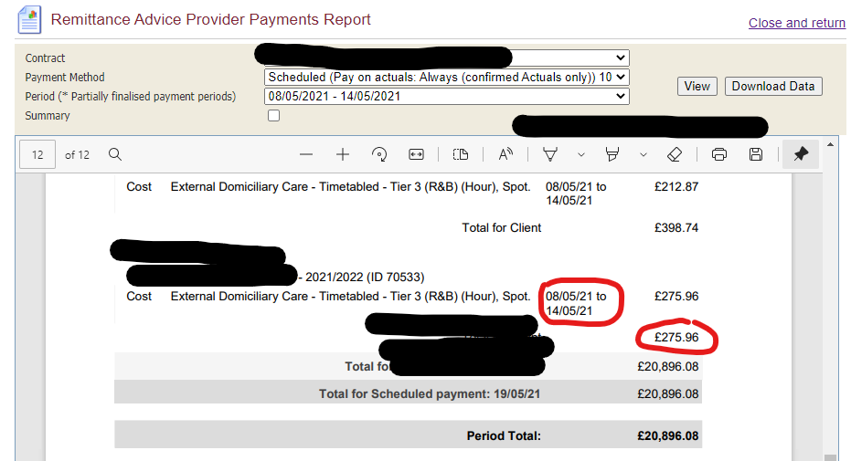
continued.
Notes:
Sometimes there is multiple weeks on one remittance, so more grey total lines

Slide 17
Any questions?
Notes:
We are here to help, so please let us know about any questions today, or later via email
Hopefully today has been useful and informative

Slide 18
If you have got any queries please email adultsproviderportal@worcestershire.gov.uk including client ID number, period, amount and a brief explanation

